Slide 1
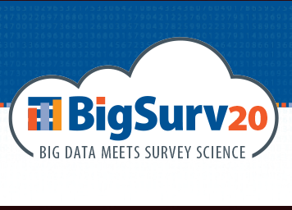
The Paradox of Data Sharing and Data Privacy in the Social Sciences
Edward P Freeland
Survey Research Center
Princeton University
Notes:
Hi my name is Ed Freeland. I am the Associate Director of the Survey Research Center at Princeton University in Princeton NJ. Today I want to talk about what I’m calling the paradox of data sharing and data privacy in the social sciences.

Slide 2
The Main Idea
The movement for open science and data sharing is intended to strengthen public confidence in science, but paradoxically contributes to a confluence of trends that may end up undermining that confidence.
Notes:
The main idea: The movement for open science and data sharing – while its intent is to STRENGTHEN the legitimacy of science – paradoxically contributes to a confluence of trends that MAY end up UNDERMINING public confidence in science.

Slide 3
The Movement for Open Science
Reduce fraud and publication of non-reproducible results
Prevent burying of unexpected results
Enhancing funder/taxpayer impact
Strengthening integrity of scientific work
Potential benefits of crowdsourcing; citizen science
Promote collaboration and efficiency
Notes:
So what is the movement for open science? It’s a movement among scientists, government officials and foundation officers who for a variety of reasons would like to see science clean up its act. This includes measures to reduce fraud and prevent the publication of study results that cannot be reasonably replicated. It’s intended to stop the practice of burying results of studies when those studies don’t work out as expected, which happens more often than you might think. This reflects a concern about maximizing the return of public investment in science. If a research study is funded by the public, the public should have access to information about the study, regardless of whether or not the results were disappointing. There’s also the simple, laudable goal of strengthening the integrity of scientific work, which is essential for how the public perceives scientists. The growth of the INTERNET now allows for completely new innovations such crowdsourced science and citizen science. That means putting a lot more open access data out there on the web, but that makes it possible for hundreds or thousands of people working remotely to make small contributions to a research study that produces big results that wouldn’t otherwise be possible. It also enables scientists to participate in wider global networks of collaborative research.

Slide 4
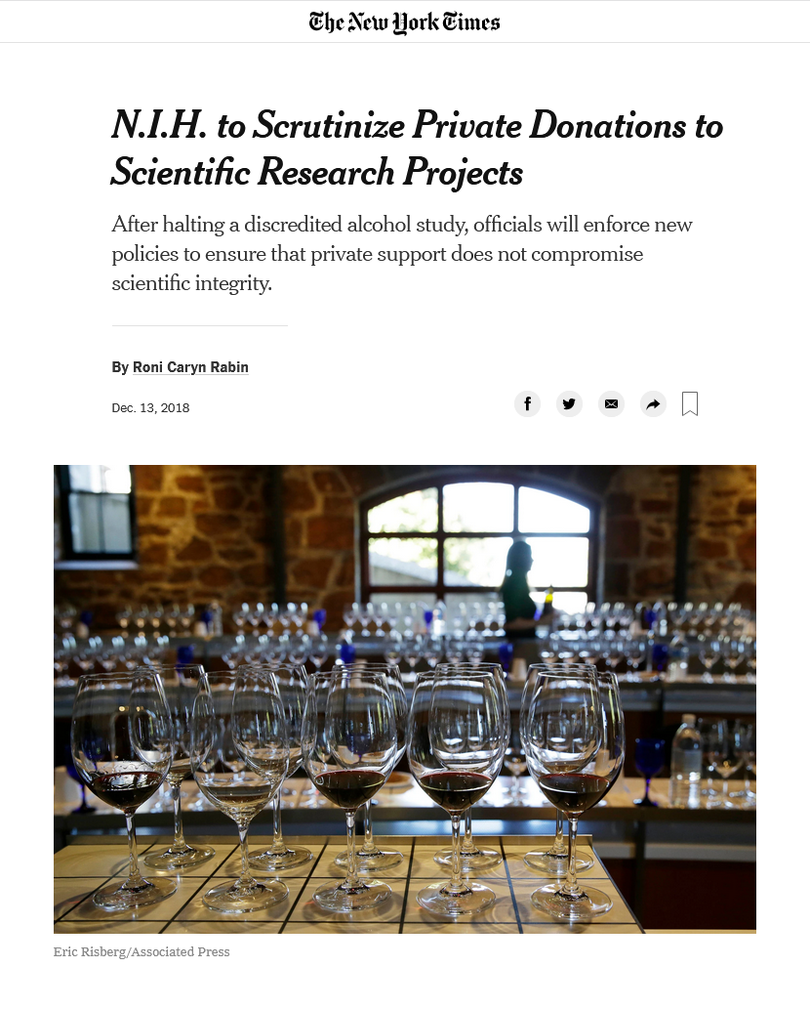
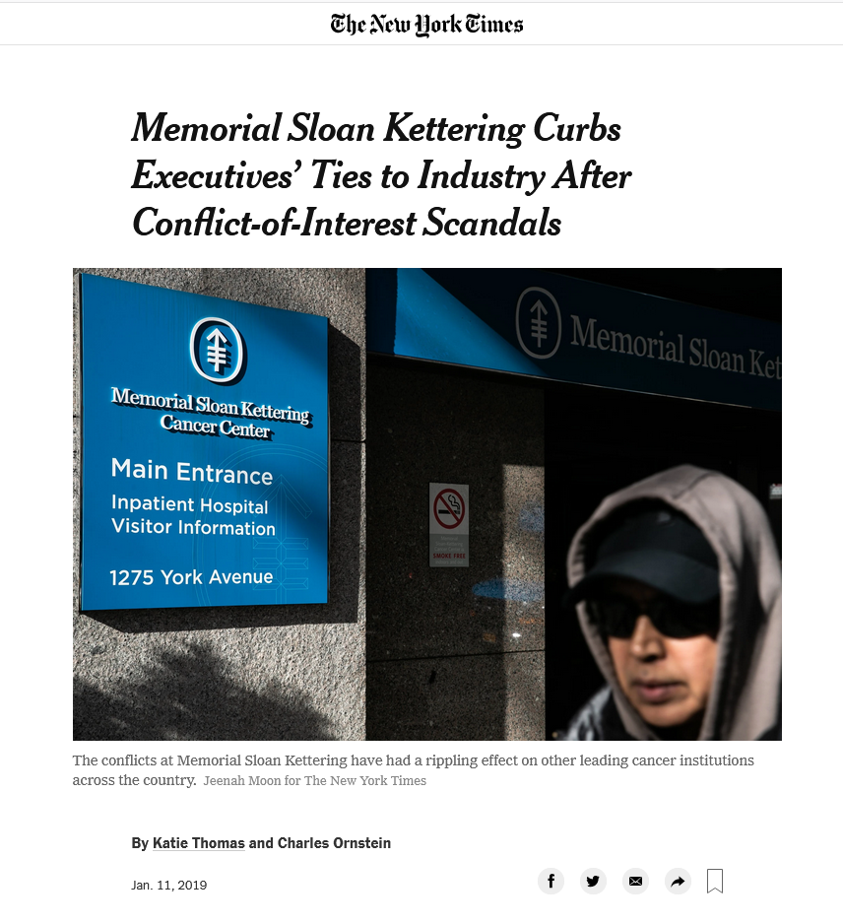
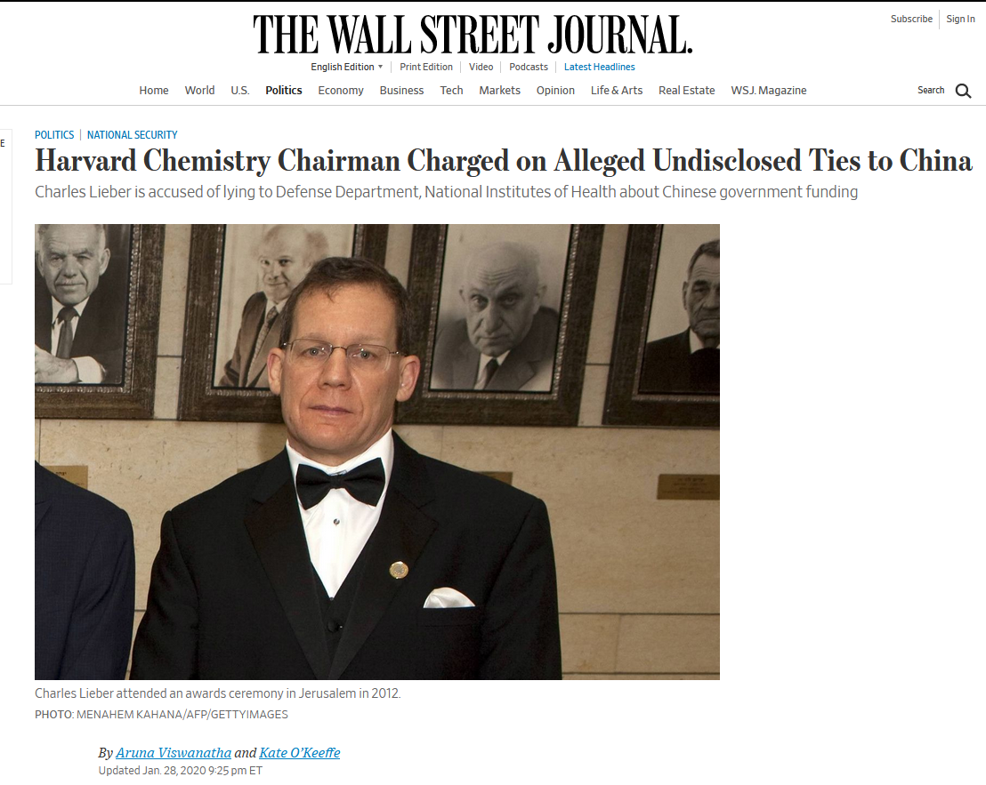
Incidents
Conflict of interest cases
Retractions and frauds
Polling failures
Non-replicable results
Notes:
What were some of the things that prompted the open science movement? First is a number of well known conflict of interest cases in which scientists were found to have had undisclosed financial interests, received funds from inappropriate sources, or had inappropriate ties to foreign governments.

Slide 5
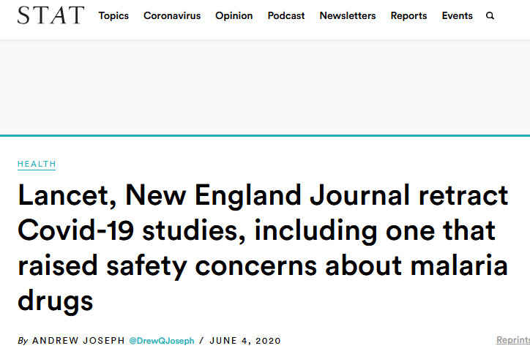
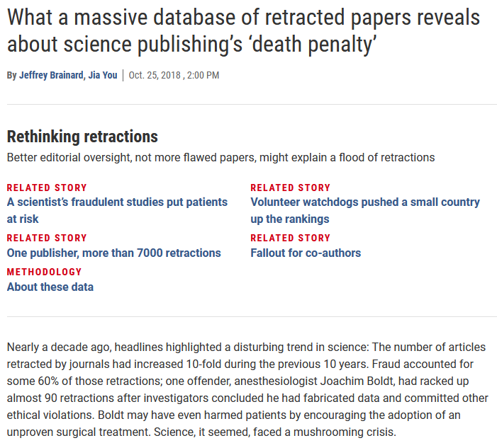
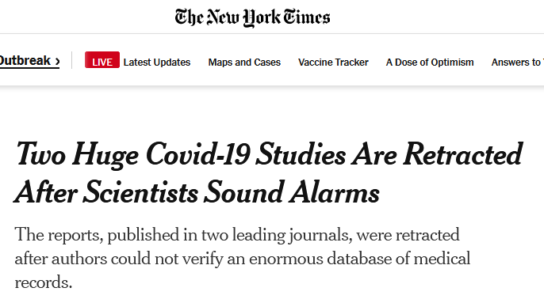
Incidents
Conflict of interest cases
Retractions and frauds
Polling failures
Non-replicable results
Notes:
Next was a number of high profile cases of plagiarism, fraud and retractions of published scientific papers, the most recent example being the high-profile retraction of papers published in the Lancet, a British medical journal, and the New England Journal of Medicine. These studies were based on data from Surgisphere, a company that collects massive amounts of data from hospitals around the world. Because the company would not cooperate with independent reviewers who requested access to the raw data , the study authors requested that the journals retract the studies that were based on the Surgisphere data.

Slide 6
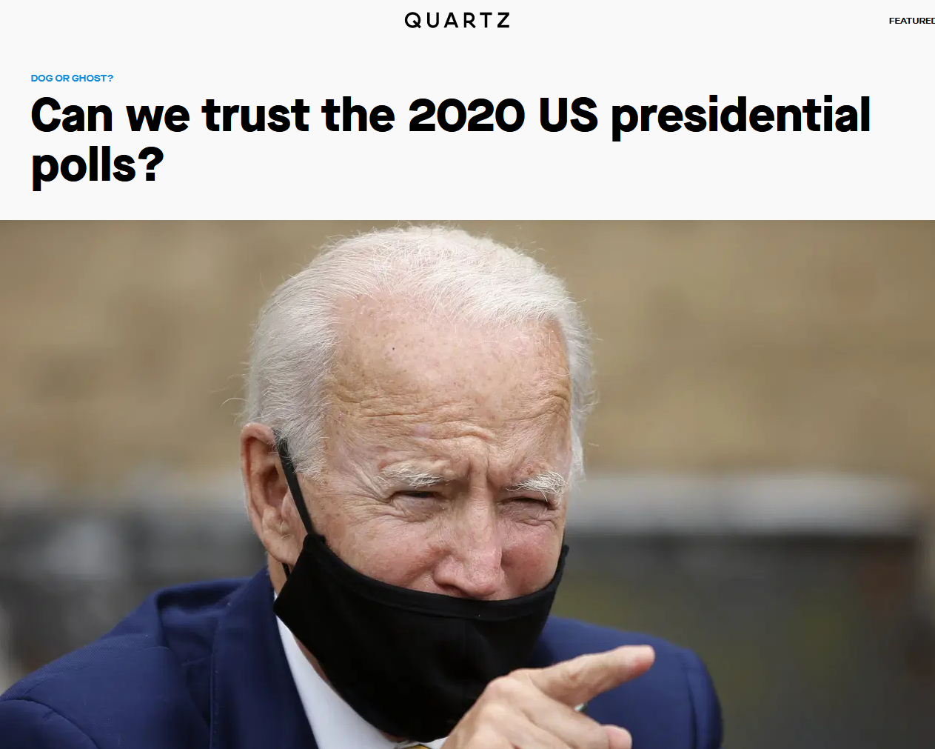
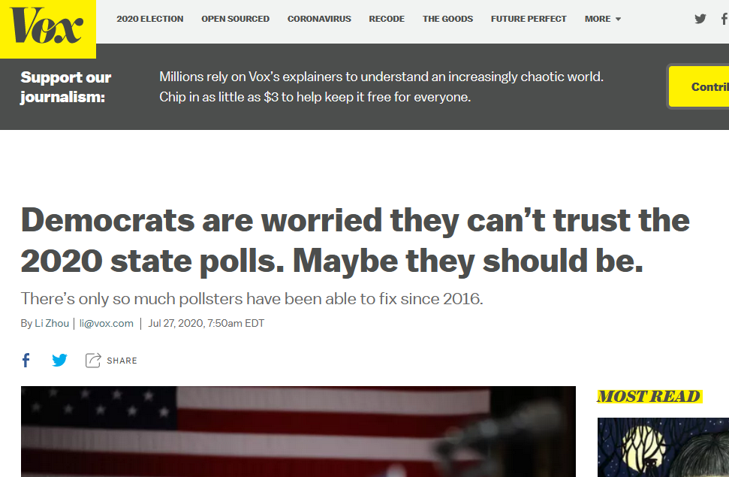
Incidents
Conflict of interest cases
Retractions and frauds
Polling failures
Non-replicable results
Notes:
My field, the science of polling and survey research, took a pretty serious public relations hit after the 2016 presidential election. CLICK Many of the STATE polls that were aggregated in order to estimate the outcome of the election pointed toward a victory for Hillary Clinton. CLICK And as everyone know, things didn’t work out that way. CLICK Even though many of the problems in the industry have now been cleared up, in part through an effort known within the profession as the Transparency Initiative, we’re seeing even greater levels of cynicism in the general public in the current round pre-election polling.

Slide 7
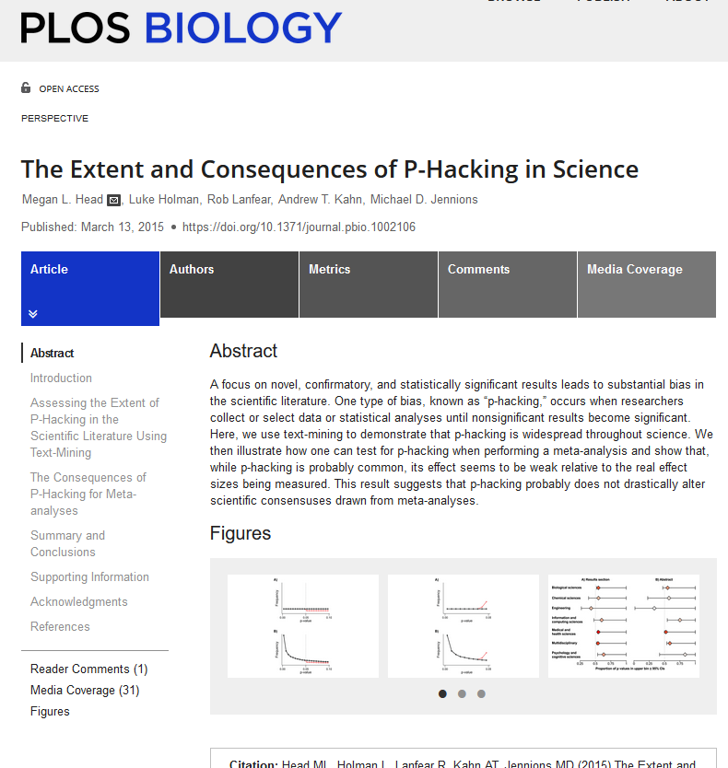
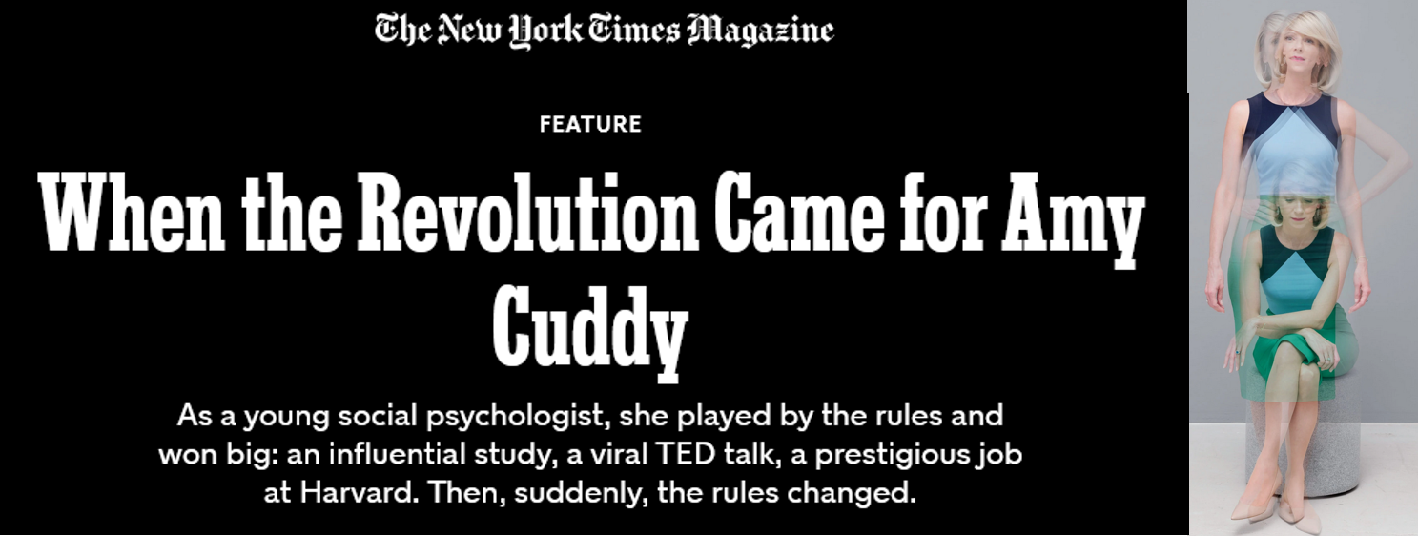
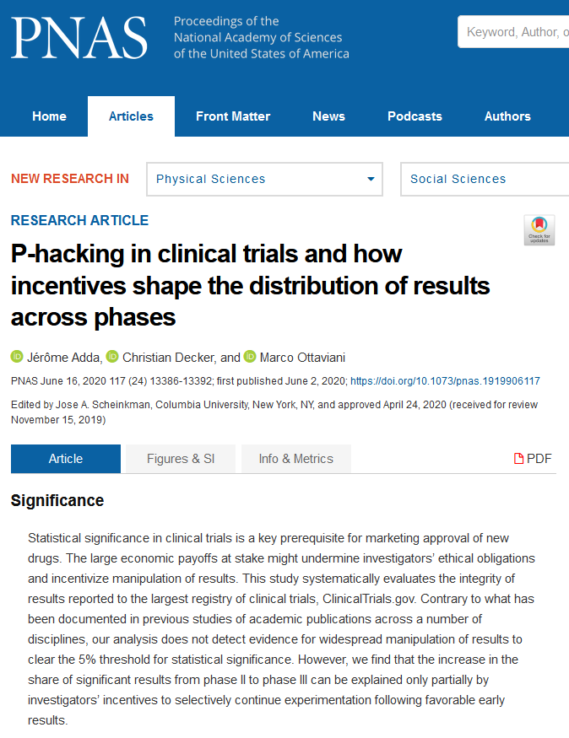
Incidents
Conflict of interest cases
Retractions and frauds
Polling failures
Non-replicable results
Notes:
There are also a number of recent cases involving studies which had well publicized results but turned out to be difficult to replicate. These cases set off a big debate within science about the practice of p-hacking and the use of arbitrarily set statistical criteria for rejecting null hypotheses. As we all know, anybody can use data (even purely random data) to run a hundred regression models and get four or five statistically significant results. Clearly we need systems in place to prevent those results from becoming four or five papers published in scientific journals.

Slide 8
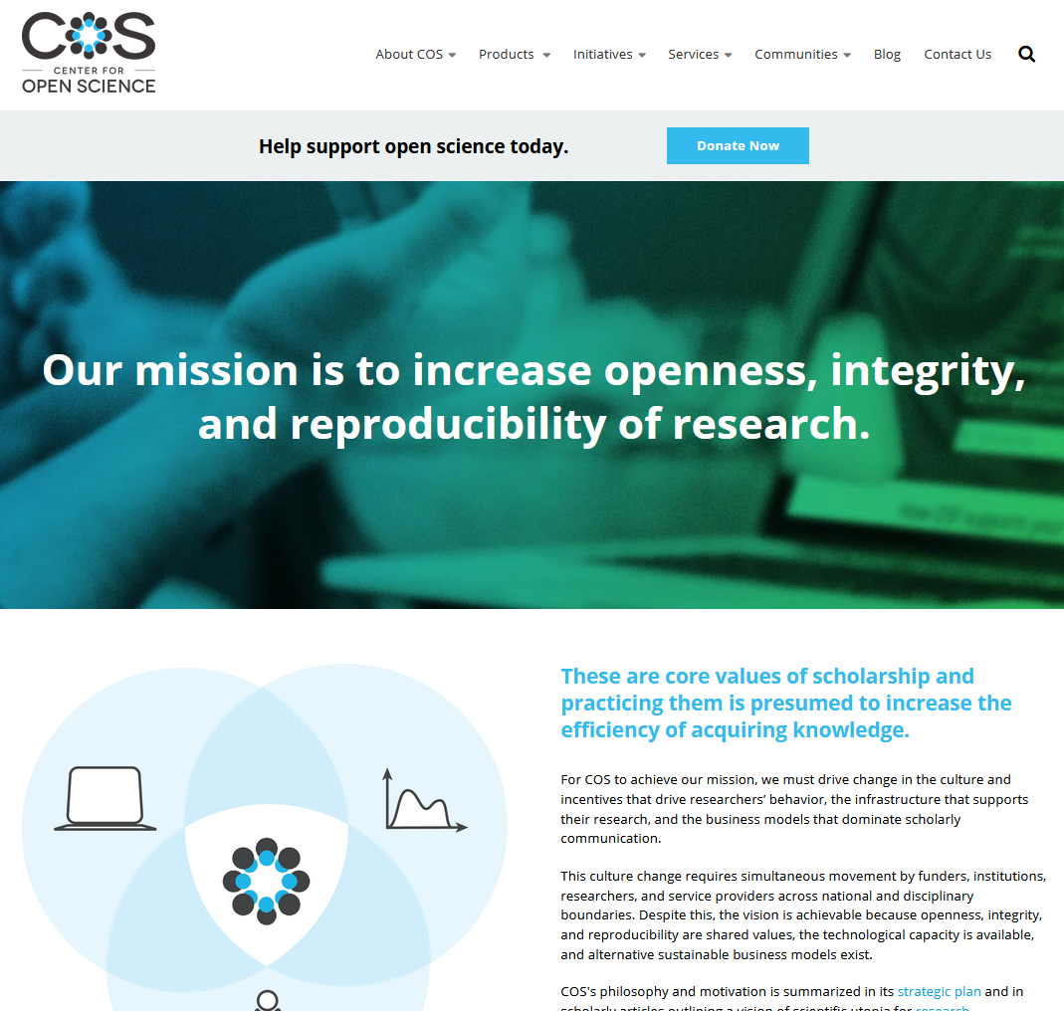
Notes:
This is the Center for Open Science at the University of Virginia. It’s now become common practice for researchers to go to this website (or to Clinical Trials dot gov) to pre-register their data analysis plans and hypotheses at the outset of their research. And many journals now require this (as well as IRB review) as a pre-condition for reviewing articles for publication.

Slide 9
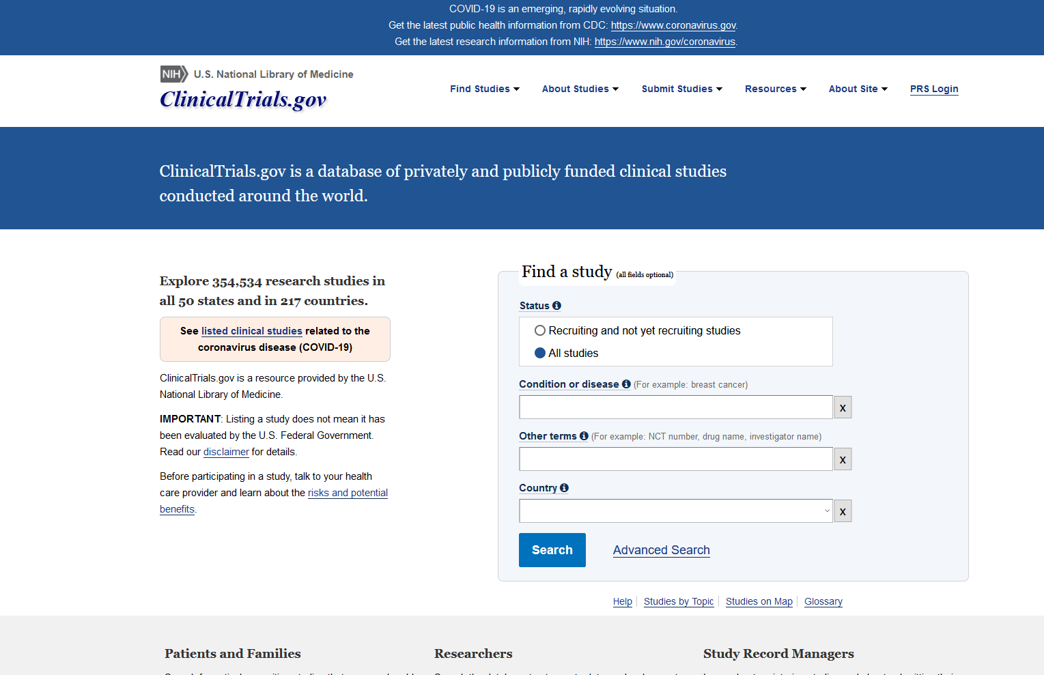
Notes:
And here is the clinical trials website. As you can see its gotten quite large, more than 350,000 scientific studies registered there. That’s a great development to see in turns of public access.

Slide 10
Archiving and Sharing Data
Changing expectations for the end stages of a typical research project
Range of options for sharing/archiving data files
Restricted use files; licensing agreements
Preparing public use data files
No authoritative norms or guidelines
Removal of explicit identifiers (e.g., HIPAA)
Top-coding, reducing detail in code categories (e.g., occupation: 867 to 23)
Geographic masking
Notes:
Opportunities for preserving and archiving data have expanded greatly over the past decade. That’s meant re-thinking the typical endpoint of a study, which used to be publication of results, but now includes publication of the data and the code used for the analysis as well. There’s also been a growth in the number of locations around the country that provide restricted access to census data and data from the IRS and other agencies that are now available to researchers. When it comes to the preparation of public use files, however, there are no definitive standards for how to do this. There’s not much beyond the obvious deletion of explicit identifiers, such as the ones listed in the HIPAA standards. There’s also things like top coding, collapsing categories and geographic masking that can be used to prevent identification of study subjects through inference.

Slide 11
Does Anonymization Really Work?
Data landscape and risk of re-identification changing year by year
Archived research data sets piling up in an environment that has seen vast improvements in quality and quantity of publicly available data on persons
Potential problems?
Growth of personal data industry
Distributed “anonymous” workforces (Amazon Mechanical Turk)
Increasing sophistication of re-identification attacks
Best to assume that all data are potentially identifiable and potentially sensitive (Salganick 2018)
Notes:
That’s all led to a concern about whether or not anonymization of data actually works. At my center, we now avoid using the term anonymous as much as possible and refer to our data protection measures as confidential. There are still problems though. There’s been tremendous growth in the volume and accessibility of personal information available for sale on the Internet. Political parties and many corporations have built up massive data files that know a lot about you and me and the US is way behind Europe when it comes to regulating this industry. As for handling confidential data in our own work, it’s best to assume ALL data are potentially identifiable.

Slide 12
Public Confidence in Science
Not much confidence that privacy will be adequately protected
Public trust in science has held steady despite declining trust in most other institutions
Rising costs and declining responses rates for all surveys
Burgeoning hostility to government data collection
Notes:
All this adds up to a pretty serious challenge to the confidence of the general public when it comes to protecting privacy. We know from surveys that public trust in science has held pretty steady over the years, but there’s still not a lot of confidence in the organizations that are responsible for protecting data with personal information. That’s reflected in declining response rates in surveys as well as a growing hostility to government data collection.

Slide 13
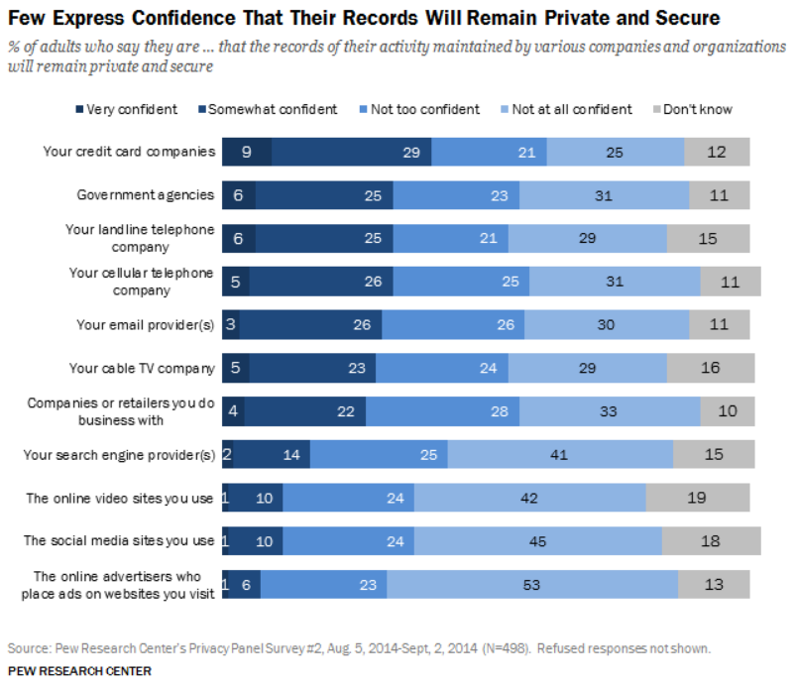
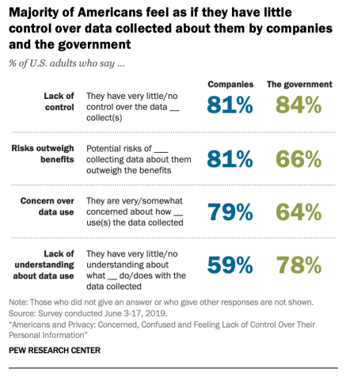
Notes:
You can see from the survey data here that credit card companies are trusted more than government agencies when it comes to keeping personal data secure, but, overall, less than half the public says they are somewhat or very confident in the ability of EITHER credit card companies or the government to protect that information. CLICK More recent data from the Pew Research Center show that large majorities of Americans feel they have very little control over their personal information and a real lack of understanding in when, where or how this information is used.

Slide 14
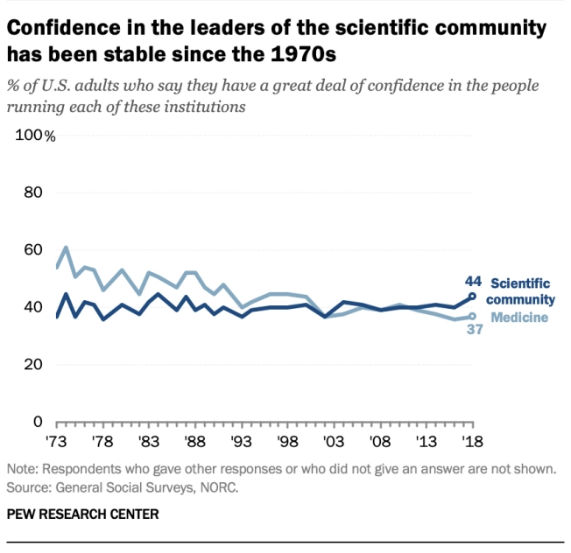
Source: Cary Funk and Brian Kennedy. Public confidence in scientists has remained stable for decades. Pew Research Center. August 27, 2020
Notes:
One of the great stories of pubic opinion research has been the long slow decline in public trust of major social institutions (especially different branches of the government) over the last 70 years. That’s even true of declining confidence in medical science as you can see here. But confidence in science has held up remarkably well. Nevertheless, one can be fooled by looking at the mean values year over year. You get a different picture when you split this dark blue trend line out by political orientation.

Slide 15
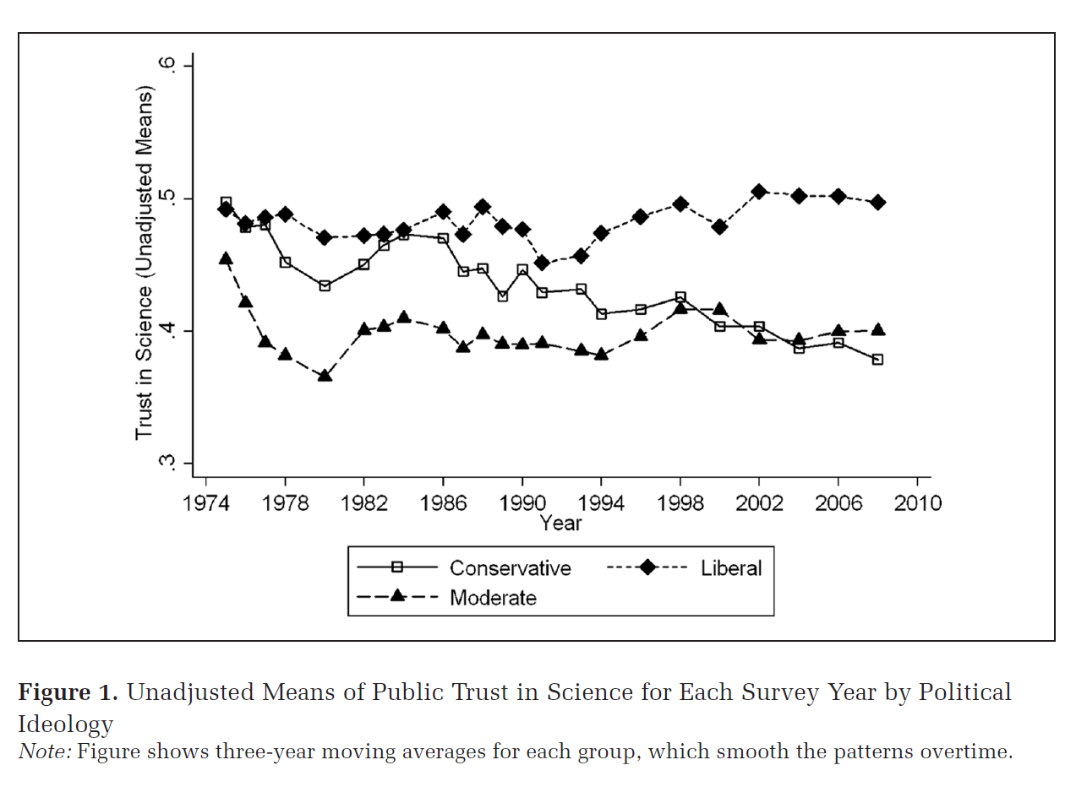
Source: Gauchat, Gordon., 2012. Politicization of science in the public sphere: A study of public trust in the United States, 1974 to 2010. American sociological review, 77(2), pp.167-187.
Notes:
This figure shows that while the mean or overall trend has been steady, conservatives and liberals are moving in opposite directions with conservatives being more distrustful of scientists over time and liberals becoming more trusting. And if you look at more recent data from the General Social Survey, you’ll this gap has gotten even wider over time.

Slide 16
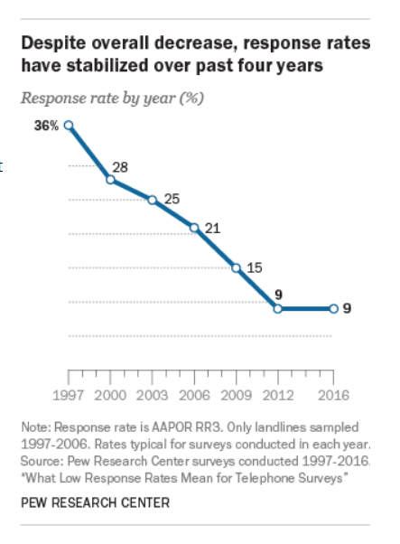
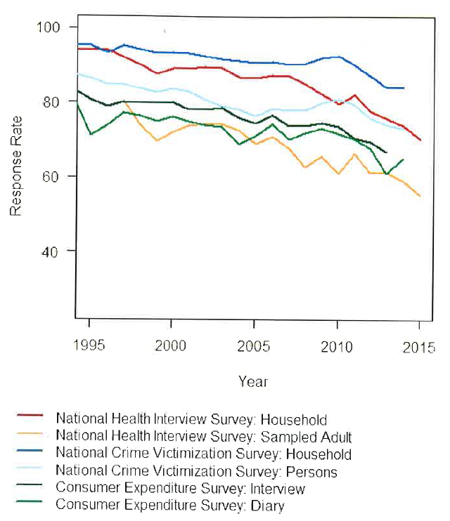
Source: National Academies of Sciences, Engineering, and Medicine, 2017.
Innovations in Federal Statistics: Combining Data Sources While Protecting Privacy. National Academies Press. P. 24.
Notes:
And here you can see the long term trend in declining response rates over time for both the large federal government surveys and for polls of the general public done by the Pew Research Center. This to me clearly signifies a gradual erosion of civic participation and a growing cynicism about the need for social research and statistical data collection.

Slide 17
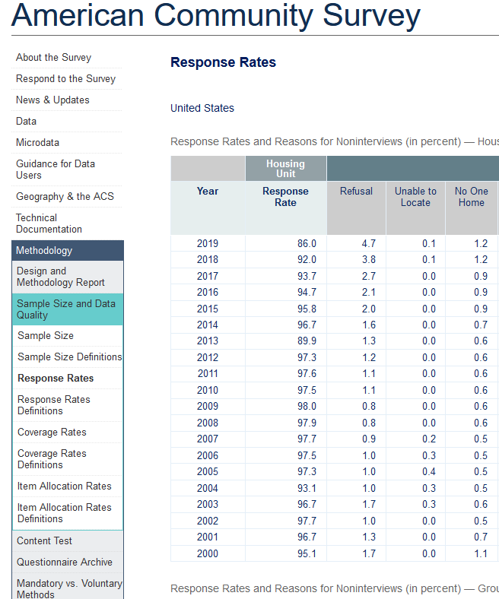
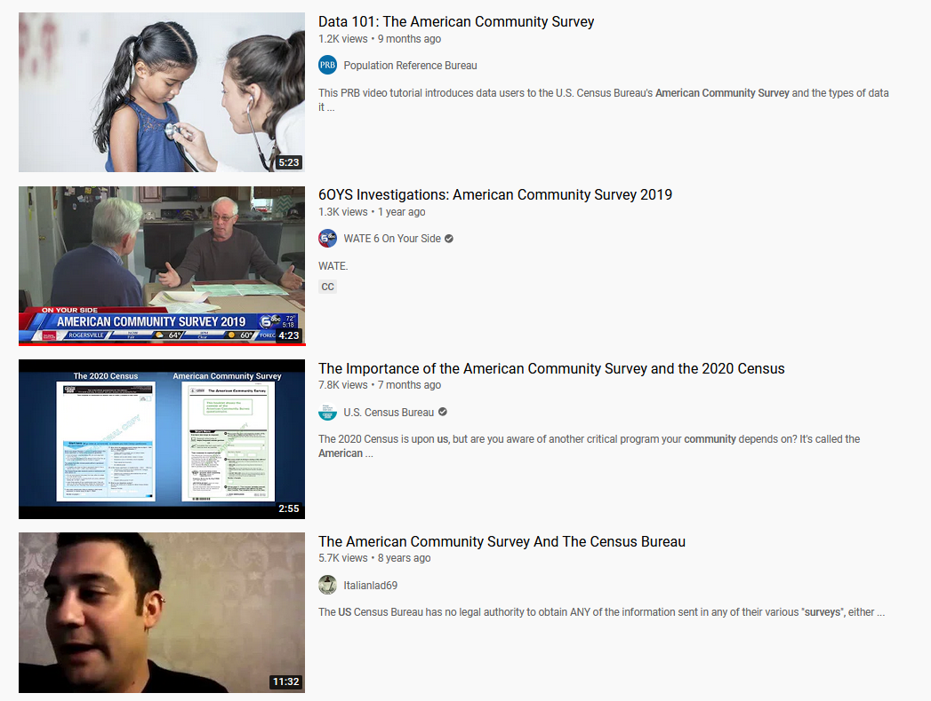
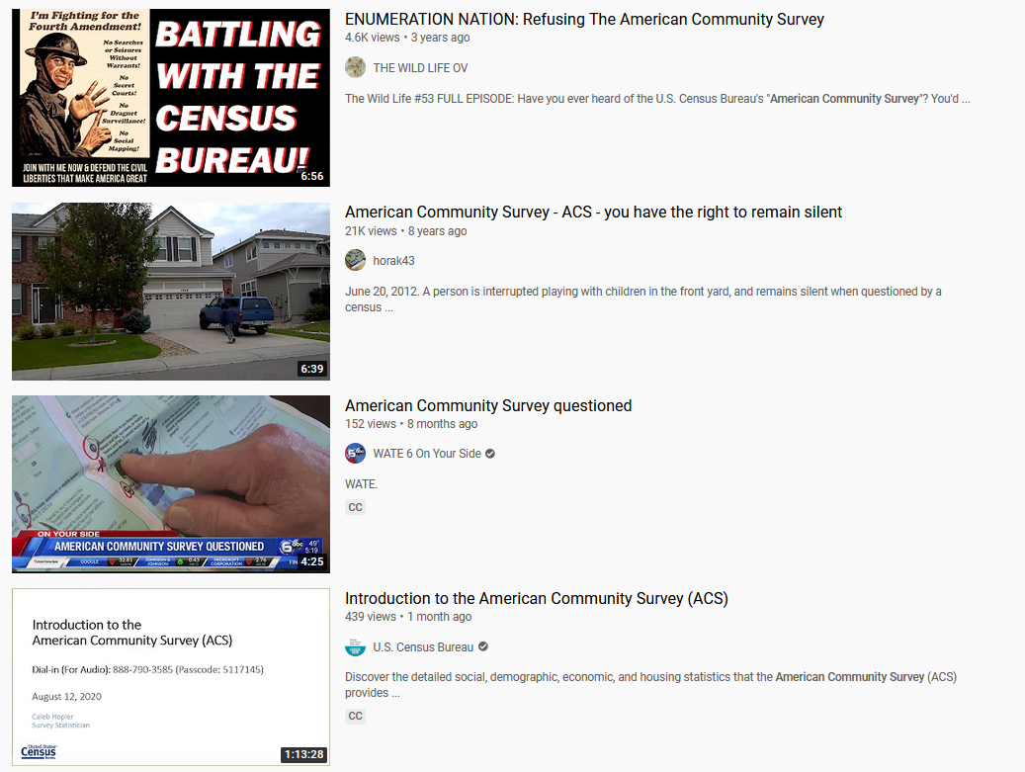
Growing Hostility Toward Collection of Official Statistics
Notes:
To get a sense of that, just go on YouTube and search for videos about the American Community Survey, one of our most important sources of data for social science research. There’s a palpable, and in my view shameful, hostility out there toward the ACS. And the threat is real. These videos are having an impact. CLICK You can see here that ACS response rates were in the high 90s from 2000 until 2015. In 2016, they dropped to the low 90s. And last year (2019) was the first time the response rate dropped below 90 percent. If you’re looking for a dead social science canary in the coal mine, this is it.

Slide 18
EPA Proposed Rule Changes
Limits acceptability of studies that will not provide access to confidential information
Includes tiered access to confidential medical records and personal identifiers of study participants
Retroactive: Older studies may now be excluded from consideration in rule making
Studies showing harm of chlorpyrifos rejected last month as “inconclusive” due to lack of access to raw data despite concurrence of peer reviewed studies
Notes:
Although many would argue that the attack on science has on full display at the Centers for Disease Control during the COVID-19 pandemic, I want to focus in closing on a different agency. The paradox I’ve been talking about can be seen in full fruition in a set of proposed rule changes at the Environmental Protection Agency. If fully enacted, these changes will limit the admissibility of scientific studies that do not allow full access to raw data, computer code used for analysis, confidential proprietary business information, and quote-unquote de-identified medical records. This would give companies impacted by agency decisions a near-perfect tool for discrediting any studies that might affect their bottom lines. To make matters worse, the rule changes would apply to older environmental and health studies that have impacted agency decisions on pollution rules IN THE PAST but would no longer be allowed as evidence in future decisions. And just a few weeks ago, the agency rejected several studies on the dangers of KLOR PIFF EROS, an ingredient in certain pesticides, due to lack of access to the raw data in spite of the fact that those studies were peer reviewed.

Slide 19
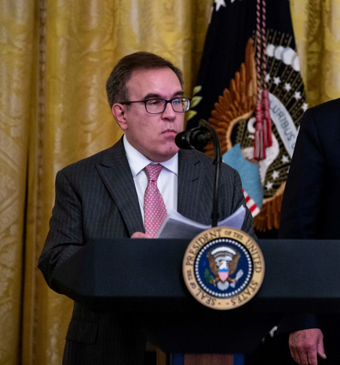
“Good science is science that can be replicated and independently validated, science that can hold up to scrutiny. That is why we’re moving forward to ensure that the science supporting agency decisions is transparent and available for evaluation by the public and stakeholders.”
Andrew Wheeler, E.P.A. Administrator
Notes:
And all of this is to be done under the guise of improving the transparency and integrity of science. As Andrew Wheeler, the current EPA administrator put it, “Good science is science that can be replicated and independently validated, science that can hold up to scrutiny. That is why we’re moving forward to ensure that the science supporting agency decisions is transparent and available for evaluation by the public and stakeholders.” That sounds both ominous and hauntingly familiar.

Slide 20
Takeaways
Greater availability of “anonymized” study data and the proliferation of public and private databases with personal identifying information increase the likelihood of harmful data disclosures
Those disclosures will feed into a growing cynicism about the value of data collection for social science and government statistics
The drive to increase trust in science through transparency, while laudable, means data with confidentiality protections may ultimately be viewed as less trustworthy
That creates opportunities for vested financial interests to attack science that threatens corporate profits
Notes:
So, in conclusion, my four main takeaway points

Slide 21
Slide Presentation
Available at:
https://psrc.princeton.edu/archive
Questions: efreelan@princeton.edu
Notes:
So, in conclusion, my four main takeaway points

