Slide 1
The Gift of Trust
René Bekkers
Global Trust Research Consortium
https://globaltrustresearch.wordpress.com/
BigSurv18 Conference, October 27, 2018

Slide 2
Would you say…
In general most people can be trusted?
OR:
You can’t be too careful in dealing with other people?

Slide 3
Fundamental Questions
Are we losing faith in each other?
How does trust develop over the life cycle?
How do generations differ in trust?
Why are citizens in some countries more trusting than in other countries?
How is trust based on experience?
How does trust affect health, income, well-being, and prosocial behavior?

Slide 4
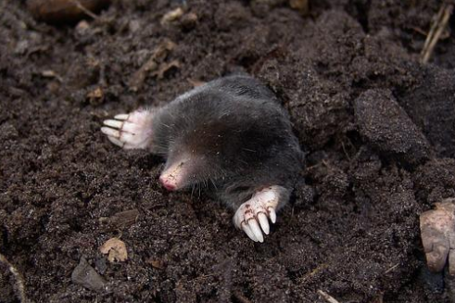
Yet we work like…

Slide 5
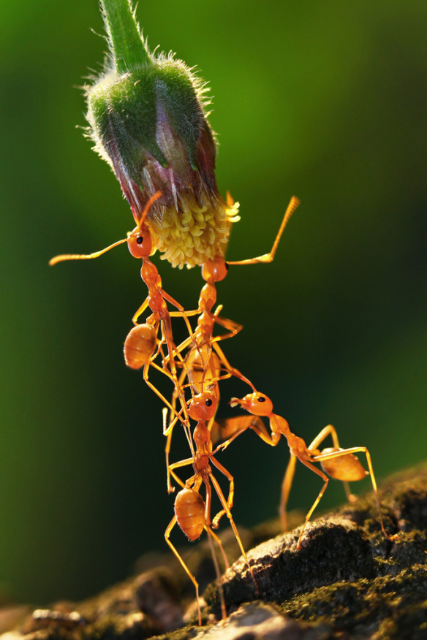

Slide 6
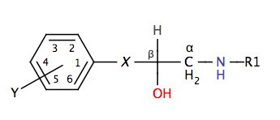
Beta blockers

Slide 7
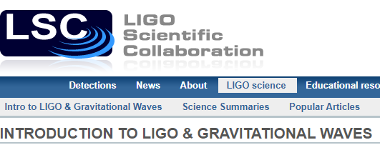
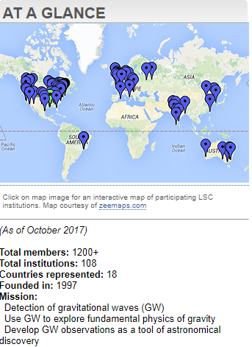
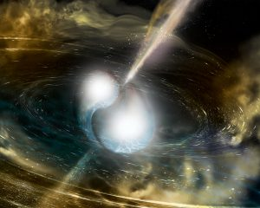

Slide 8
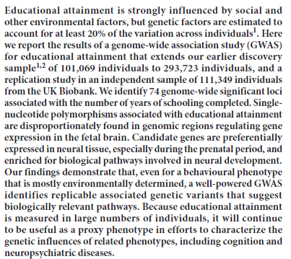

Slide 9
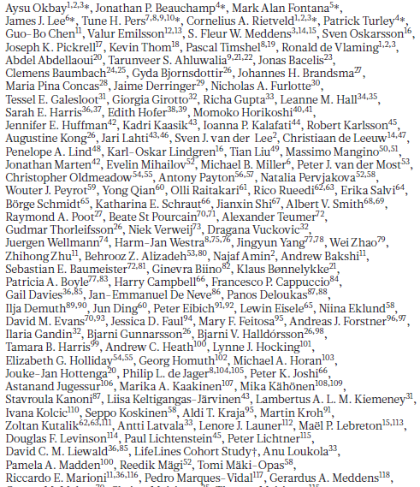
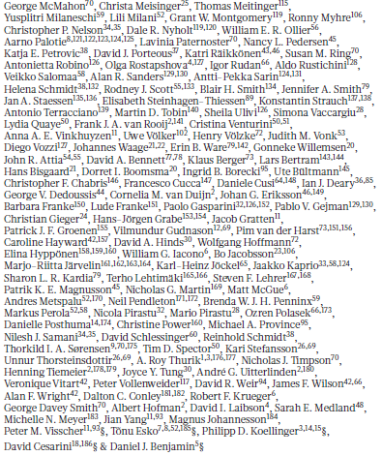

Slide 10
Consortium Benefits
Huge n – more power.
Generalization.
Validity in comparative research.
Efficient use of existing data.
Publications.
https://globaltrustresearch.wordpress.com/

Slide 11
n per year

Slide 12
Ex Post Survey Data Harmonization
A process:
in which different survey datasets that were not specifically designed to be compared are pooled and adjusted (i.e. recoded, rescaled, or transformed) to create a new integrated dataset that could be analyzed as a typical single-source dataset; and
that is based on clear criteria that specify which datasets are included into the new dataset and clear methods for how variables in the new dataset are created.
Dubrow & Tomescu-Dubrow, 2014

Slide 13
Work flow
Identify a survey not yet included
Categorize the methodology: trust measure, data collection mode
Provide code for harmonization
Add harmonized data
See results
Analyze data

Slide 14
Mega-analysis
An analysis of data pooled from different sources, with characteristics of the data sources as covariates.
A trust response depends on characteristics of the responder, the measurement, time, and context – all cross-nested.
Bekkers, R. (2016). Introducing Mega-analysis. July 27, 2016. https://renebekkers.wordpress.com/2016/07/27/introducing-mega-analysis/

Slide 15
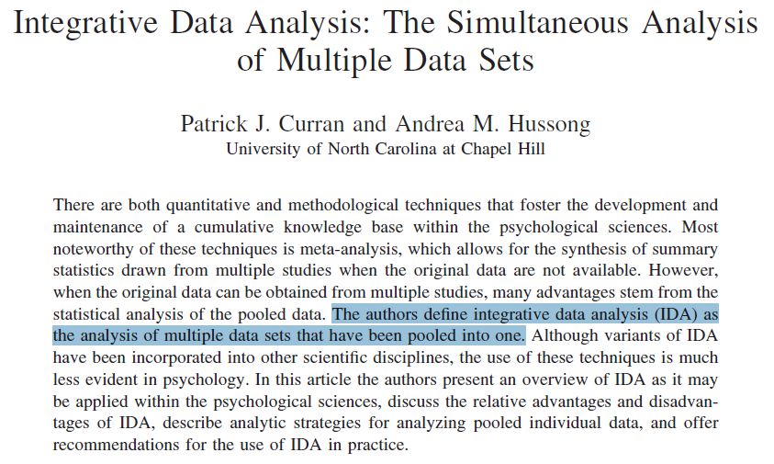

Slide 16
Meta vs Mega-analysis
Meta-analysis also allows scholars to analyze the collective evidence on a certain phenomenon
But meta is only possible on released reports, and susceptible to publication bias
Power is limited to the #studies
→ Meta-analysis of Individual Patient Data (IPD) = Mega-analysis

Slide 17
Global Trust Research Consortium
René Bekkers, Bart Sandberg, Eric Uslaner, Zhongsheng Wu, Tom van der Meer, Arjen de Wit, Erik van Ingen, Lisanne de Blok, M. Kent Jennings, Bert Bakker, Dustin Gilbreath, Rati Shubladze, Matthew Eckel, Cengiz Enrisen, Gino Pauselli, Thessalia Merivaki, Laura Morales, Sonja Zmerli
Open Science Framework: https://osf.io/qfv76/
You are most welcome to join us!

Slide 18
Harmonized Trust Database
Multinational surveys: ISSP, WVS, EVS, ESS, EQLS, Eurobarometer, Survey of Adult Skills (PIAAC), CID, ICCS, ICILS, PGPE
National: general social surveys, national election surveys, longitudinal panel studies
We have identified ~365 surveys since 1953.
Rough estimate: these surveys include about 2/3 of all trust responses ever collected
The currently harmonized data include almost 4 million observations

Slide 19
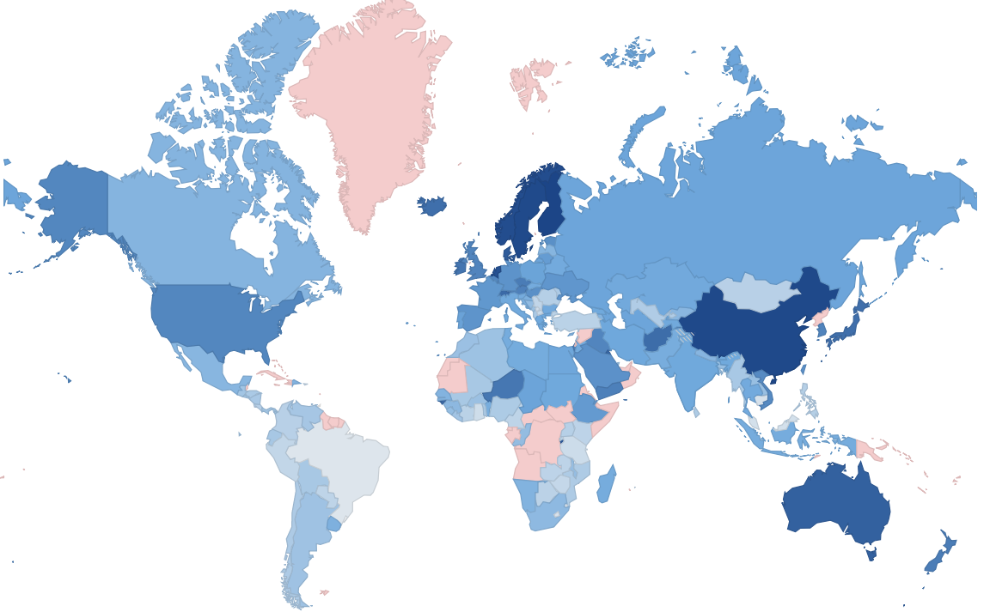
Trust Score by Country

Slide 20
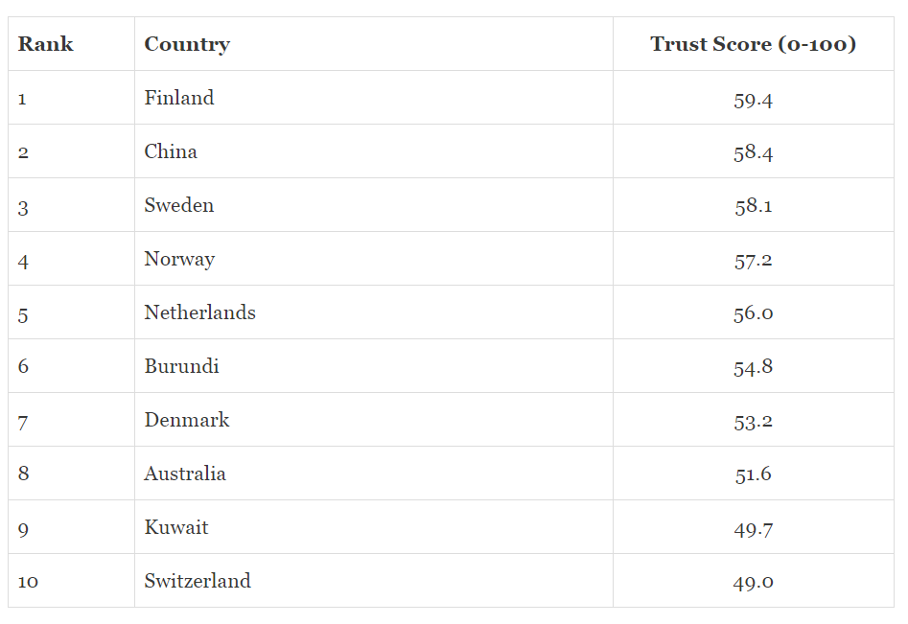

Slide 22
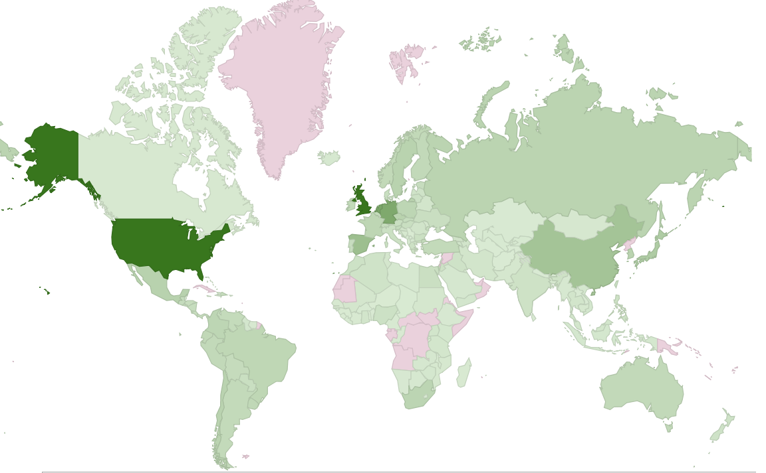
Number of surveys per country

Slide 23
Varieties of trust items
Would you say… In general most people can be trusted? OR: You can’t be too careful in dealing with other people?
= ‘Forced choice’ format (0 – 1), the Rosenberg original (1953), probably from Noelle-Neumann (1942)
With option ‘It depends’ offered
With option ‘Don’t know’ added
These poles as Likert items on various scales
1-4, 1-5, 1-7, 1-10, 0-10 == ESS
Other statements about human nature (1-5)

Slide 24
ESS 0-10 scale yields more trust
Bekkers, R. & Sandberg, B. (2018). Grading Generalized Trust Across Europe. Paper presented at the 6th ESS workshop, March 16, 2018, The Hague. https://osf.io/qntze/

Slide 25
ESS 0-10 scale yields more trust
Bekkers, R. & Sandberg, B. (2018). Grading Generalized Trust Across Europe. Paper presented at the 6th ESS workshop, March 16, 2018, The Hague. https://osf.io/qntze/

Slide 26
ESS 0-10 scale yields more trust
Bekkers, R. & Sandberg, B. (2018). Grading Generalized Trust Across Europe. Paper presented at the 6th ESS workshop, March 16, 2018, The Hague. https://osf.io/qntze/

Slide 27
ESS 0-10 scale yields more trust
Bekkers, R. & Sandberg, B. (2018). Grading Generalized Trust Across Europe. Paper presented at the 6th ESS workshop, March 16, 2018, The Hague. https://osf.io/qntze/

Slide 28
HTD at 5 levels
154
1953-2017
365
8
3,828,342
Country
Time
Survey
Scale
Individual

Slide 29
Variance in trust at 5 levels
9.9%
5.6%
11.4%
3.3%
80~85%
154
1953-2017
365
8
3,828,342
Country
Time
Survey
Scale
Individual
Percentages are ICC estimates: Intra Class Correlation coefficients (ρ in ‘empty’ intercept-only models) for levels 1 to 4 in separate regressions

Slide 30
Development of Trust in the US
N = 307,502

Slide 31
Age Differences in the US
N = 307,502

Slide 32
Cohort Differences in the US
N = 307,502

Slide 33
Cohort Differences in the US
N = 307,502

Slide 34
Generational Decline at Age 17-20
Monitoring the Future, n = 114,402

Slide 35
Age and Cohort in the US
N = 307,502

Slide 36
Age and Cohort in the UK
N = 324,272

Slide 37
Age and Cohort in Germany
N = 81,959

Slide 38
Age and Cohort in the Netherlands
N = 57,710

Slide 39
Income Inequality Fosters Distrust

Slide 40
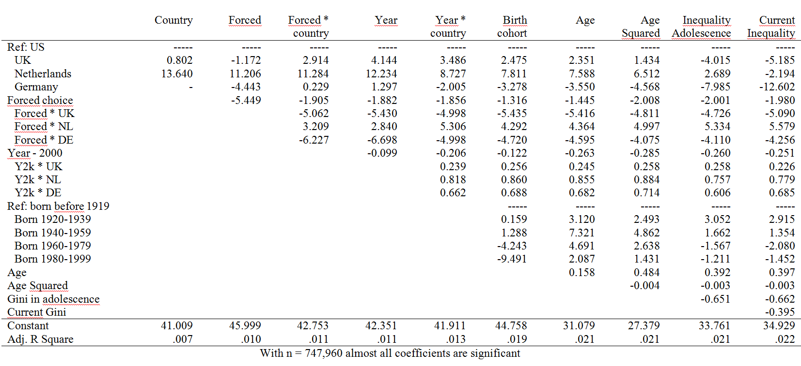

Slide 41
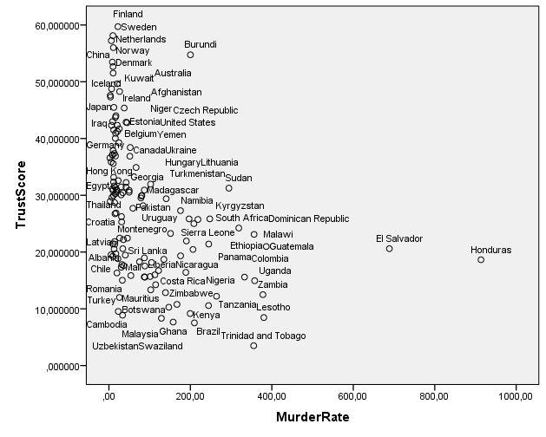
Violence and Trust
r = -.42

Slide 42
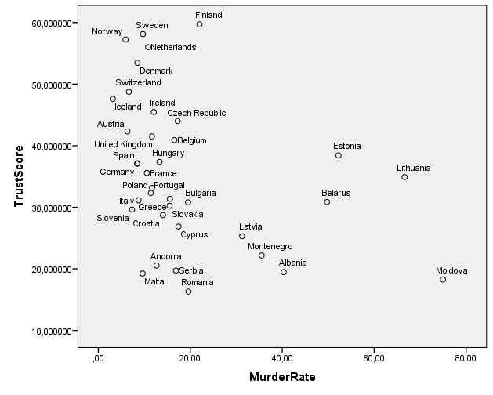
Relation within Europe strongly negative
r = -.36

Slide 43
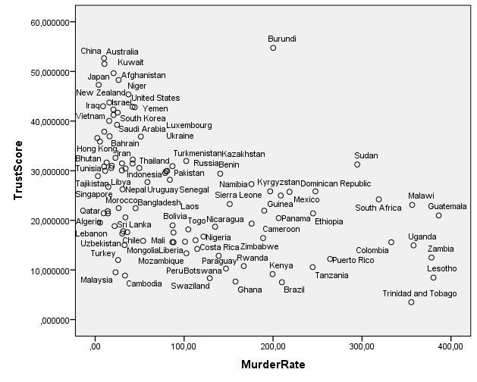
Relation outside Europe also strongly negative
r = -.46
El Salvador and Hunduras omitted; if included r = -.38

Slide 44
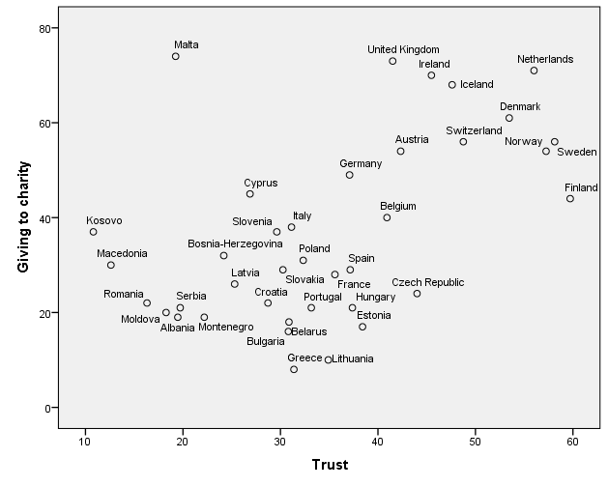
Trust makes Europeans give
r = .52
https://renebekkers.wordpress.com/2018/03/22/the-force-of-everyday-philanthropy/

Slide 45
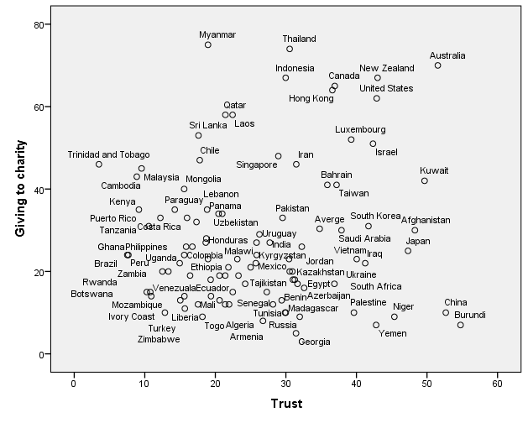
Relation much weaker outside Europe
r = .11

Slide 46
Let’s collaborate.
René Bekkers
@renebekkers
r.bekkers@vu.nl
This project is on the Open Science Framework, https://osf.io/qfv76/
Notes:
46

Slide 47
Potential Methods Effects
Question order: before / after questions that generate a ‘warm glow’
Response category format: 0-1, 1-5, 1-7, 1-10, 0-10
Mode of data collection: face-to-face, paper-and-pencil, online
Data quality: response rate, #missings, interviewer ratings of ‘cooperativeness’

Slide 48
Comparable projects
Luxemburg Income Study [LIS]
International Stratification and Mobility File [ISMF] in Sociology
Cross-national Survey Data Harmonization [SDH] Project
Durand et al. on political trust

Slide 49
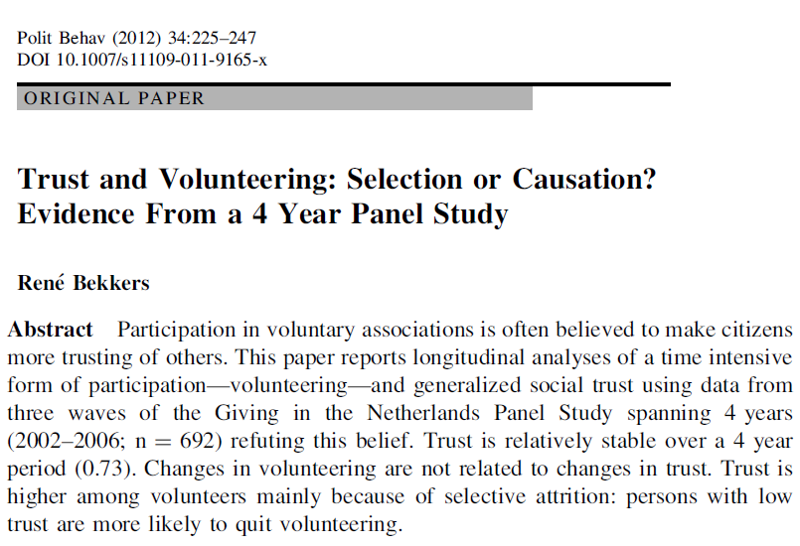

Slide 50
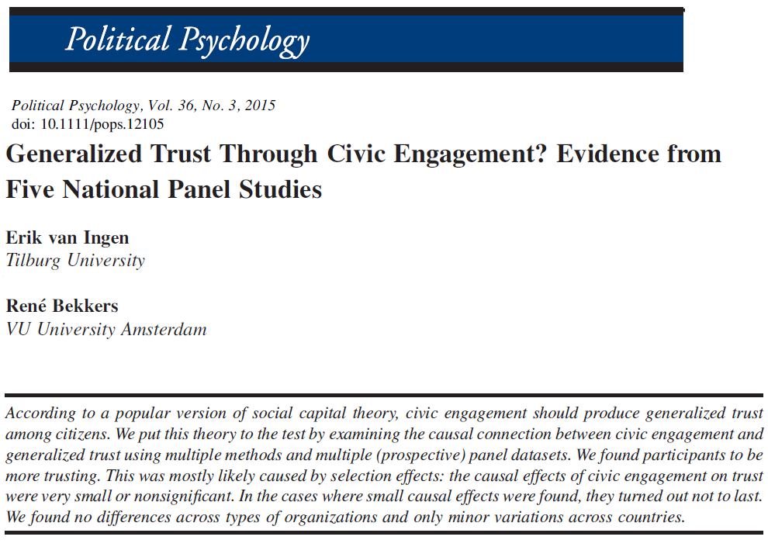

Slide 51
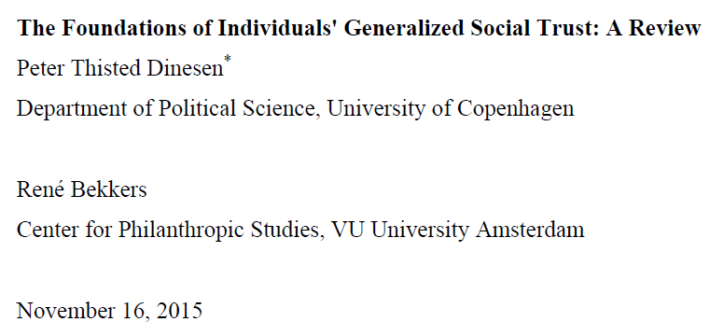
Pp. 77-100 in: Van Lange, P.A.M., Rockenbach, B., & Yamagishi, T. (Eds.). Trust in Social Dilemmas. Series in Human Cooperation, Volume 2. Oxford: Oxford University Press. https://osf.io/umdxg/

Slide 52
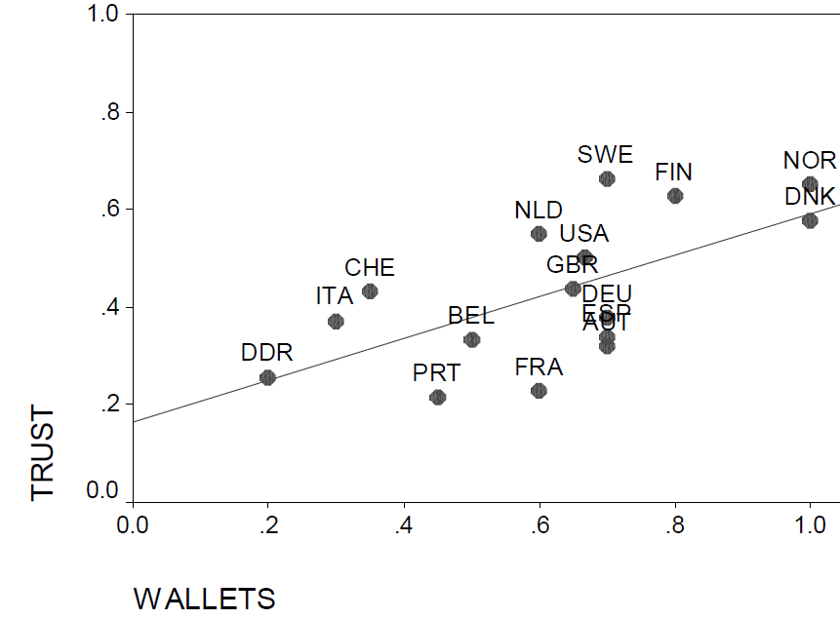
Average trust in World Values Survey and proportion of wallets returned
in Reader’s Digest experiment – Figure from Knack, 2001

Slide 53
