Slide 1

Machine Learning and Verbatim Survey Response
Classification of Criminal Offences in the Crime Survey for England and Wales
Peter Matthews
26/10/2018

Slide 2
The Crime Survey for England and Wales (CSEW)
The Crime Survey for England and Wales
A random probability in-person household survey of victimisation:
  Respondents are asked about crimes they have experienced in the last year
Originated in 1982 as the British Crime Survey
Sample size currently c. 35,000 interviews per year with adults aged 16+
Response rates generally around 70-75%

Slide 3
CSEW is used in official estimates of the crime rate in England and Wales
Source: Office for National Statistics Crime in England and Wales: Bulletin Tables (Year ending March 2017)
Number of offences
(thousands)

Slide 4
CSEW is used in official estimates of the crime rate in England and Wales
Source: Office for National Statistics Crime in England and Wales: Bulletin Tables (Year ending March 2017)

Slide 5
1.
The crime classification problem

Slide 6
CSEW offence classification
There are 87 different final offence codes, across 11 categories of crime
1. Assault
2. Attempted assault
3. Sexual assault
4. Robbery and
snatch theft
5. Burglary
6. Theft
7. Attempted theft
8. Criminal damage
9. Threats
10. Fraud*
11. Computer misuse*
*Fraud and Computer misuse were added in 2016. An additional set of questions is included in the survey to capture these cases. They are not included in the coding classifier given the limited training data available.

Slide 7
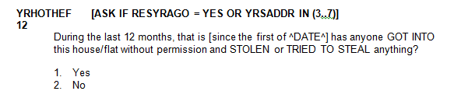


CSEW offence classification
Screener questions
Verbatim description of incident
(open question)
Incident characteristics
(closed questions)
+

Slide 8
CSEW offence classification
Incidents are assigned an offence code based on the open-text verbatim and supplementary (closed) questions
Initial coding
Supervisor coding
ONS coding

Slide 9
2.
A big data solution?

Slide 10
Crime classifier: An ensemble workflow
Stage 1
Stage 2
Training set 1
50% (c. 110k)
Training set 2
30% (c. 66k)
Test set
20% (c. 44k)

Slide 11
Crime classifier: An ensemble workflow
Stage 1
Stage 2
Training set 1
50% (c. 110k)
Training set 2
30% (c. 66k)
Test set
20% (c. 44k)
Input:
For each code, three binary prediction models:
Text descriptions
(open ended)
Incident characteristics
Logistic regression
Gradient boosting
Random forest

Slide 12
Crime classifier: An ensemble workflow
Stage 1
Stage 2
Training set 1
50% (c. 110k)
Training set 2
30% (c. 66k)
Test set
20% (c. 44k)
Input:
For each code, three binary prediction models:
Input:
Multinomial model
predicting offence code
Text descriptions
(open ended)
Incident characteristics
Predicted probabilities from stage 1 models
Logistic regression
Gradient boosting
Random forest

Slide 13
Crime classifier: Training performance
Training set 2

Slide 14
Crime classifier: Test performance
Test set

Slide 15
Core model: Areas for improvement
Text pre-processing
Stage 1 modelling
Stage 2 modelling
Spellchecker
Bespoke list of stop-words
Part-of-speech tagging
Smarter pre-processing of closed questions
Closer tuning of stage 1 models
Add other model types to the ensemble (e.g. Support Vector Machines, Neural Networks)

Slide 16
3.
Analysis of errors

Slide 17
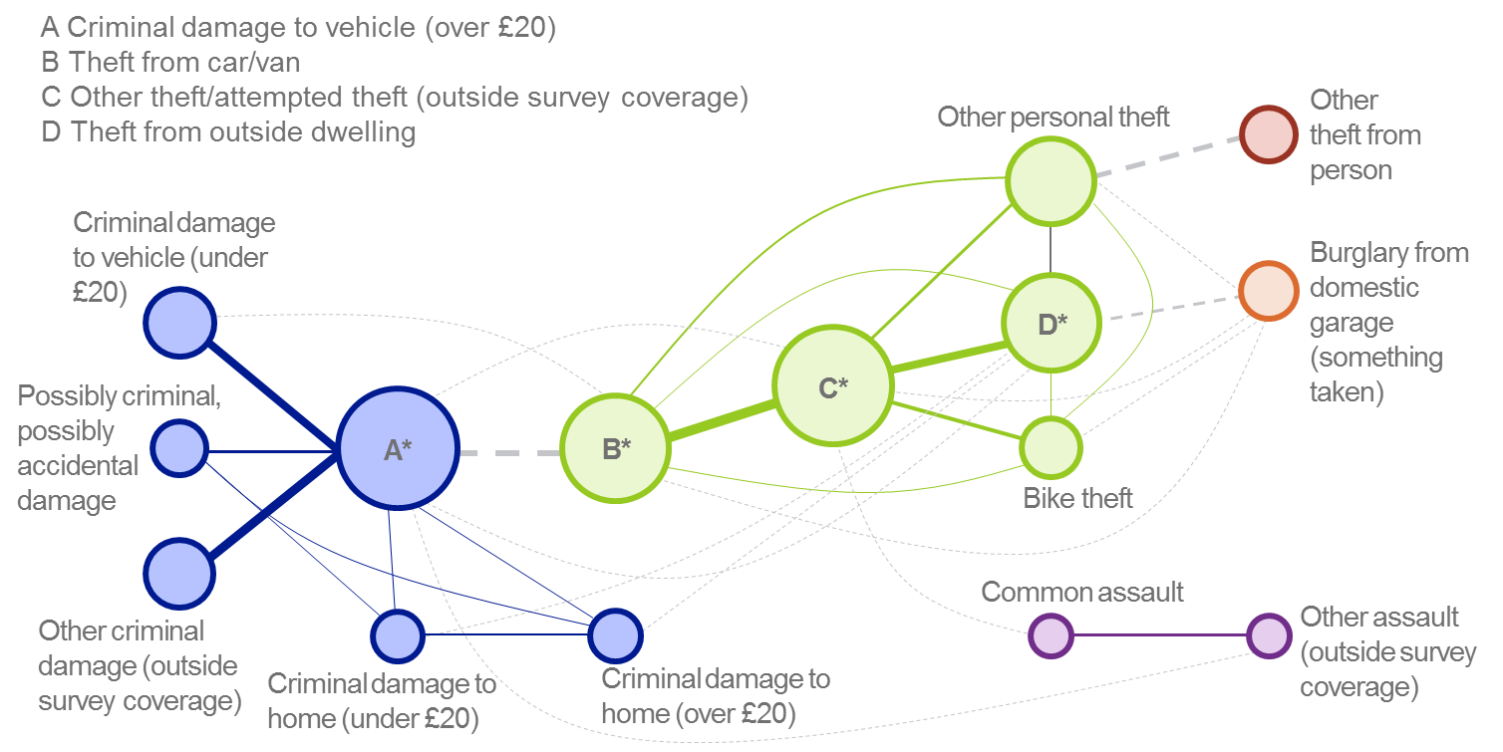
Core model (97% threshold): Network of errors
This network of 15 codes covers 55% of errors
Notes:
Size of node = number of ‘errors’ associated with that code
Width of edge = number of ‘errors’ associated with that pair of codes
Colours identify codes of the same crime category (e.g. Blue = criminal damage)

Slide 18
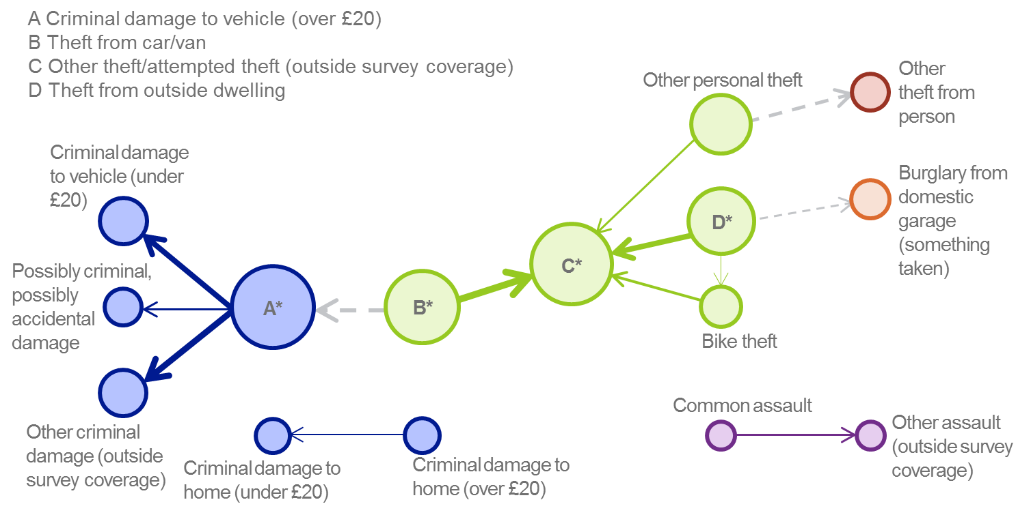
Core model (97% threshold): Network of errors
These paths account for 41% of errors
Notes:
The base of the arrow is the code predicted by the classifier.
The end of the arrow is the code actually assigned in the manual coding process.

Slide 19
Types of error
In a minority of cases, the code assigned matched a code used earlier in the manual coding process

Slide 20
Types of error
A little over half of errors were assigned to the correct category of crime

Slide 21
Types of error
‘Duplicate’ incidents are extremely difficult to detect automatically

Slide 22
4.
Deconstructing the model

Slide 23
Stage 1 input features
Relying on the text description alone leads to poor recall

Slide 24
Stage 1 input features
At highest thresholds, text and closed questions in combination are much more effective than either one alone

Slide 25
Stage 1 input models
Using different types of model in combination was more effective than relying on only one type…

Slide 26
Stage 1 input models
Using different types of model in combination was more effective than relying on only one type…

Slide 27
Stage 1 input models
…although using only random forests at stage 1 produced a model almost as effective as the full model

Slide 28
5.
Risks of deterioration in model performance

Slide 29
Change in performance over time
Under this simulation, recall started to fall after three years
-6ppt
-7ppt
-7ppt

Slide 30
6.
Conclusions

