Slide 1
Does administrative health register data provide reliable information for health indicators in Finland?
Hanna Tolonen, Jaakko Reinikainen, Tiina Laatikainen, Päivikki Koponen

Slide 2
Background
Health information is needed to support evidence-informed policy decisions.
Different data sources exist: health surveys and administrative registers
What is the quality and coverage of these different data sources?
Which data sources should be used to calculate different health indicators?
Twitter: @THLResearch @tolonen_hanna

Slide 3
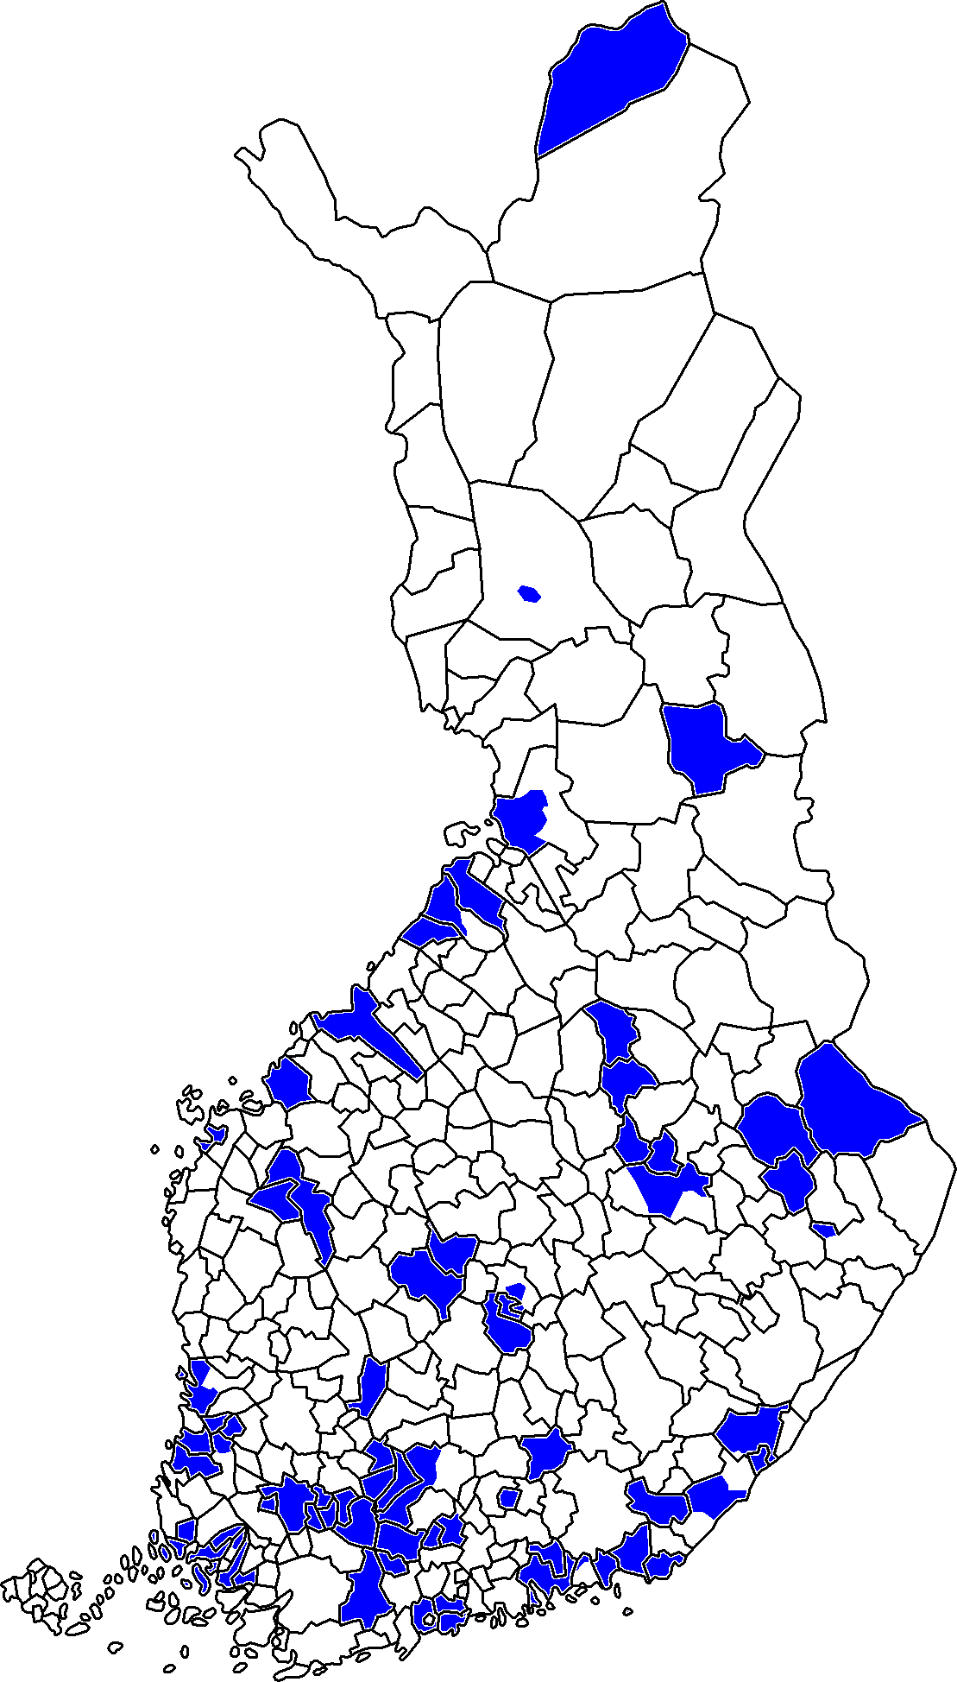
FinHealth 2017 survey
A random sample of adult population aged 18+ years from main-land Finland
Sample size n=10,305
Participation rate of 58%
50 municipalities around the country
Conducted in January-June 2017 by five teams travelling around the country

Slide 4
Administrative data sources
Information on in- and out-patient visits to health care including medical operations and prescribed medications
Date of health care visit/hospitalization
Diagnoses using ICD-10 (International Classification of Diseases) and for out-patient visits also ICPC-2 (International Classification of Primary Care)
ATC (Anatomical Therapeutic Chemical) Classification codes for medications
NCSP (Nordic Classification of Surgical Procedures) for medical procedures
BigSurv2020 Conference - 2020-10-20

Slide 5
Record linkage
Informed consent
Permission from the register owner

Slide 6
Prevalence of diabetes in the population by different data sources
Survey
Register data
9%
9%
κ = 0.83

Slide 7
Prevalence of coronary heart disease in the population by different data sources
Survey
Register data
10%
9%
κ = 0.75

Slide 8
Prevalence of asthma in the population by different data sources
Survey
Register data
9%
10%
κ = 0.72

Slide 9
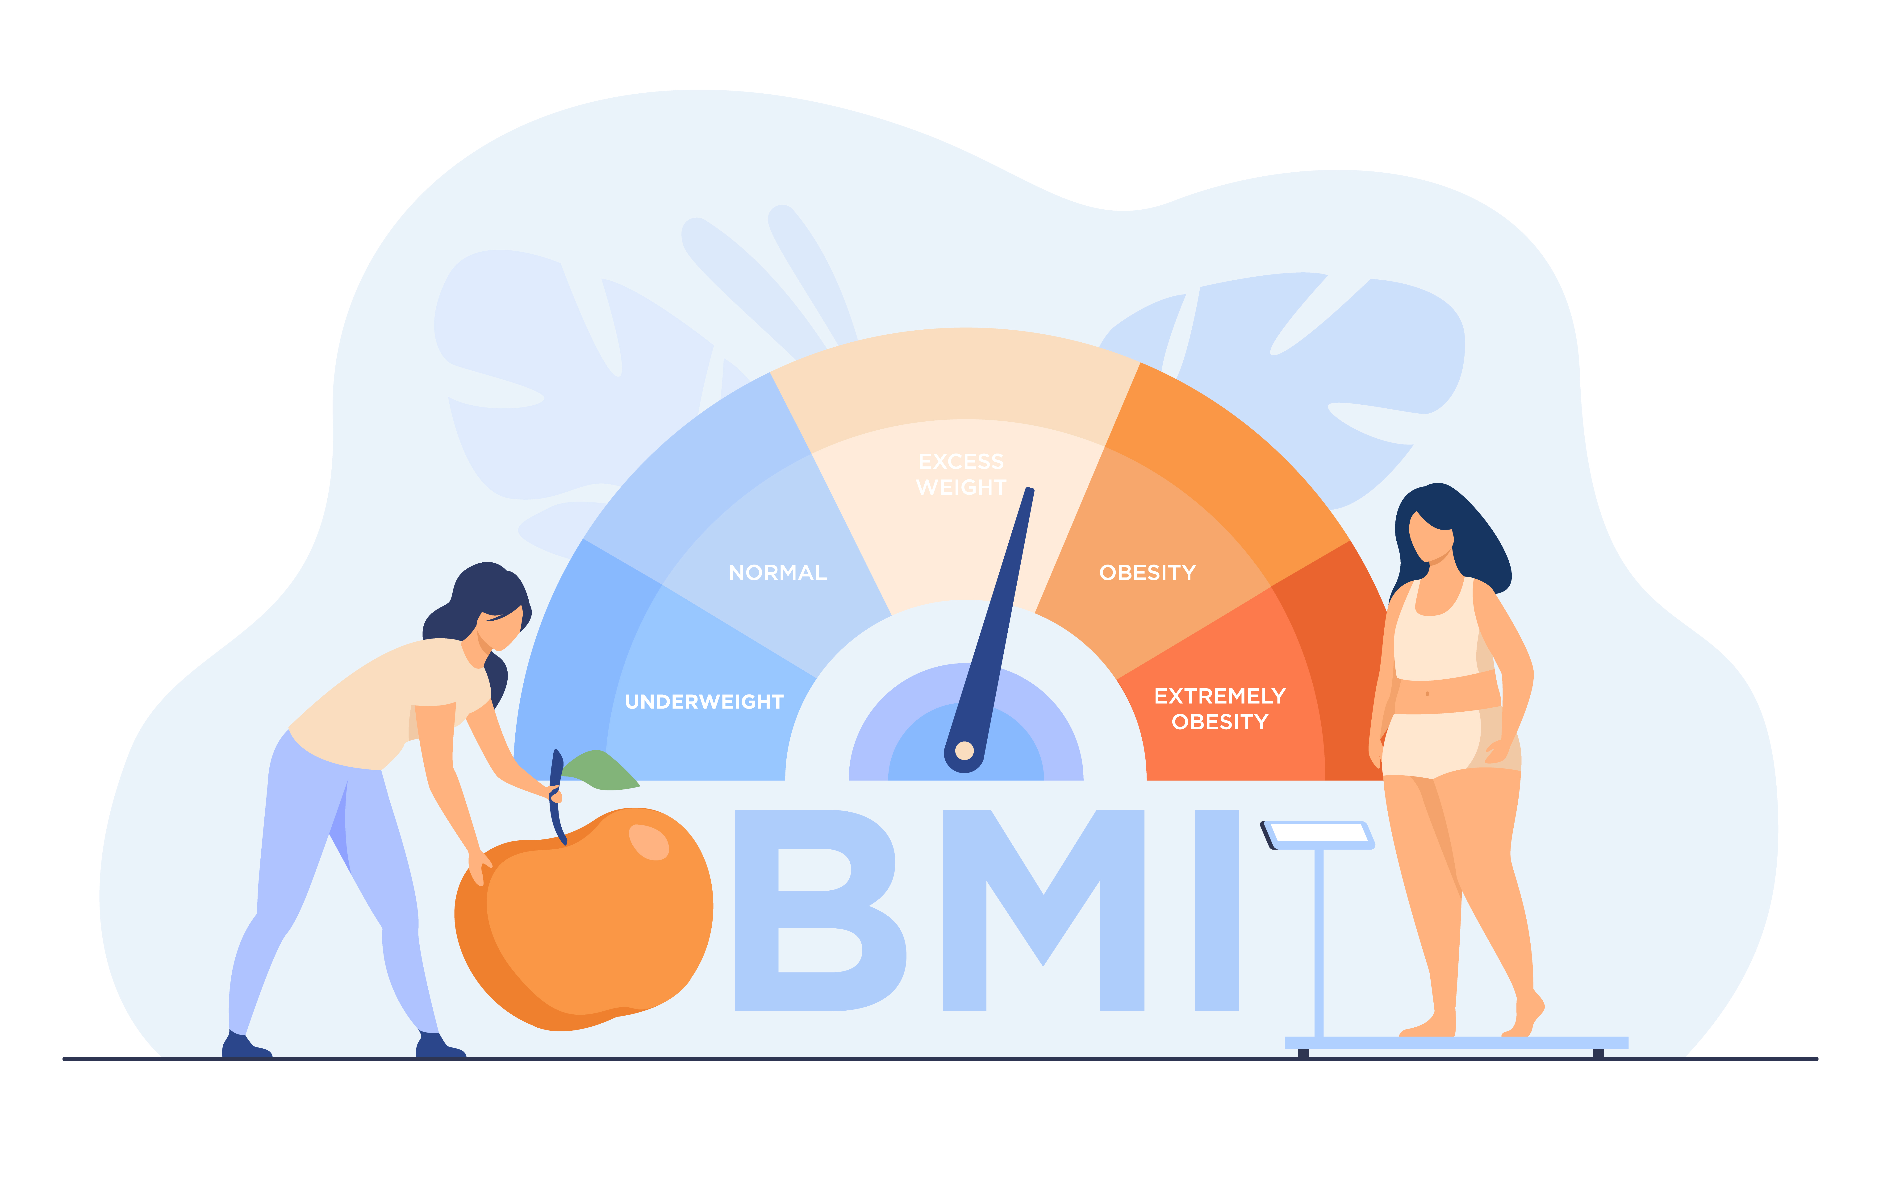
Prevalence of obesity in the population by different data sources
Survey
Register data
26%
3%
κ = 0.11

Slide 10
Prevalence of hypertension in the population by different data sources
Survey
Register data
46%
17%
κ = 0.33

Slide 11
Prevalence of depression in the population by different data sources
Survey
Register data
7%
4%
κ = 0.45

Slide 12
Pros and cons of different data sources
Health surveys
Pros
detects undiagnosed cases (e.g. potential hypertensives)
covers also private or occupational health care users
Cons
may suffer from non-response bias
self-reported data may suffer from reporting bias (awareness bias, recall bias)
expensive and time consuming to conduct

Slide 13
Pros and cons of different data sources
Administrative registers
Pros
clinically confirmed diagnoses
data accumulates automatically in more or less in real time
Cons
differences in
health care utilization in different population groups
clinical practice for different conditions and in different organizations
in patient record systems
in data entry
unspecific medication

Slide 14
Conclusions
Administrative health registers can provide reliable information on chronic conditions which require regular medication and monitoring
Risk factors such as height and weight (= BMI) and blood pressure are not systematically measured and recorded in health services
Administrative registers cover only patients while surveys are population based

Slide 15
Thank you!
Depending on health outcome, quality and coverage of different data sources varies

