Slide 1
Official statistics in the era of big data
Evaluating and improving a text classifier for subpopulations: the case of cyber crime
Arnout van Delden, Dick Windmeijer, Carlijn Verkleij
13 November 2020
Notes:
This presentation is about text classification, how we investigated whether a beta product can be used in production for official statistics.

Slide 2
Reason for investigation
ML
Cyber (y/n):
Pure (hacking …)
IT-related (purchase fraud, ..)
Police registration data (2016) on crimes
Code for crime type is registered
Texts by victims and / or police -> predict cyber?
Two labelled sets: selective (5300) and random (1700)
Notes:
In the Netherlands is a police registration, about incidents, a selection concerns crimes. The entries in the register origin either from persons reporting an incident at the police office or it concerns reports by police employees such as an incidence of domestic violence. The police uses a classification system with codes for crime type. However they do not register cyber crime. They are interested whether presence of cyber can be derived from the texts by test mining. Cyber is meant in a broad sense: pure cyber and IT-related crimes, purchase fraud, identity fraud.
Two labelled sets were created: a selective set using cyber keywords and a random set.

Slide 3
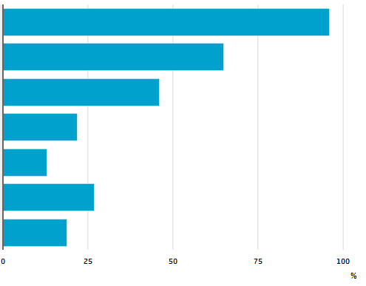
Swindle
Beta product
Forgery
Extortion
SVM bag of words model
9% cyber (820 000 records)
Precision 0.96, Recall 0.85
Can we publish reliably by crime type (subpopulation)?
How can you analyse this?
Public order crime
Violence crime
Crimes Wvsr (other)
Crimes (other)
Notes:
Early 2019 CBS has launched a beta product, where they explored whether cyber crime could be predicted.
It concerns a Support Vector Machine with bag of words model. We found that 9% of crimes were cyber related. Performance was rather good.
They published outcomes by crime type, because that is what we aim for. The question is: how reliable are those subpopulation results? We present a way to analyse this.

Slide 4
Issue of missingness
Overall 4% records without text field (may lead to bias)
Varied with crime type (50%* - 0.5%**)
Using logistic regression on background vars we found that:
Missingness (z) is not random:
z ~ crime type, declared by victim or police and main crime (yes/no)
Cyber crime (y) may be imputed
y ~ crime type, declared by victim or police and clarified incident (yes/no) (model fits the data well)
(*) Public order crime (50%); healing (40%); (**) swindle
Notes:
An issue in moving to official statistics is that not all entries have a text. That is a potential source of bias in the estimated aggregates. The missingness was very skewed and varied by crime type. The data set has a set of background variables.
With logistic regression we analyse that missingness depended on crime type and other factors. In the labelled set we found that cyber crime itself can be predicted from a number of back ground variables. So as long as missingness is not too severe, we can impute it.

Slide 5
Analysis approach
Retraining
Global model performance
Subpopulation model performance
Local model performance
Output accuracy
Test for subpop. effects
Retraining the model
Predict
Notes:
We have two blocks. In the left block I show the different levels of analysis that we used.
First of all we analysed the sensitivity of the accuracy (% cyber) for retraining the model. Second we looked into a number of global model performance measures, such as the F_1 score, recall and precision. Third we checked the errors in the prediced classes per subpopulation and Fourth we checked which words are used to predict cyber.
We retrained the model in various ways, made new predictions and computed the analysis measures for those retrained models.

Slide 6
Retraining
G2-test log-linear model effect of crime type:
association (label × prediction) (ORG)
per label (LAB)
Training settings
Basic model: single model
Binary: significant / non-significant
Deviation: each sign. crime type separately + others
All: train each crime type trained separately
Notes:
The retraining was done as follows. Using a G2 test of log-linear model we tested whether the association between label and predicted classes depended in crime type or not. Also, given a label we tested whether the error proportion depended on crime type.
We have four training settings: basic model we train using all data together. With ‘All’ we trained a separate model on each crime type. Binary we trained on two groups: all crime types that differed significantly were in one group and all other is the remaining group. Deviation: each significantly affected crime type was separately trained, plus all others together.

Slide 7
Data
First set tuning params via cross-validation on separate 300 set
Labelled sets
Random (1700): SRS sampling scheme per crime code
Selective (5300): based on keywords to find cyber
ALL = Random + Selective
Use weights when testing model performances (to correct selectiveness)
Notes:
To run the settings we have first determined the tuning parameters in a cross-validation procedure on a small, separate, set
Next we use the CBS data set which was collected by simple random sampling (SRS). This is used to assess the output accuracy. The full set, includes a selective data set. We use the full set to check for effects of crime type on model outcomes.
For all model performance results we have used weights that aim to correct for selectiveness.

Slide 8
Output accuracy of % cyber ($\hat{Y}$)
$Var(\hat{Y})$ very small
$Bias(\hat{Y})$: true % cyber under estimated
Source = random
Notes:
Concerning the output accuracy we found that the variance of the percentage cyber is very small, which is a consequence of the large number of records.
The bias of the basic model was - 1.5% which means that we estimate that the true % cyber is under estimated by 1.5%. This is because the recall for cyber was smaller than its precision. The retraining of the model had quite some effect on the bias, at least in a relative sense. The main reason is that base rate of the property that we are interested in is low.

Slide 9
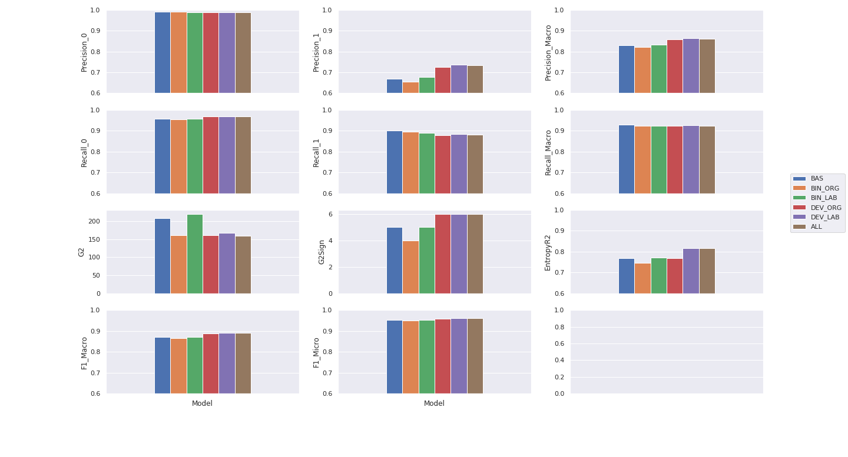
Global model performance (source = all)
Notes:
We see various performance measures.

Slide 10
Global model performance (source = all)
Notes:
First we found that the precision and recall of class 0 is better than for class 1. Within class 1 we found the recall higher than the precision. That is the reason that overall we underestimated the proportion of cyber.

Slide 11
Global model performance (source = all)
Notes:
Next we found that the G2-test values were rather high: for a number of crime types the association between label and predicted values was significantly different. Unfortunately this was not solved by retraining.

Slide 12
Global model performance (source = all)
Notes:
Furthermore, the Macro F1 was smaller than the Micro F1, because the scores of class 1 were poorer than for class 0, but it is the minority class.

Slide 13
Global model performance (source = all)
Notes:
Macro recall was higher than the Macro precision, because the precision of class 1 was small.

Slide 14
Global model performance (source = all)
Notes:
The Entropy R2 expressed the probability mass of the predicted labels compared to the true labels. That part did improve slightly with retraining.

Slide 15
Subpopulation model performance
Swindle
Forgery
Arson
Abuse
BAS
ALL
Notes:
As an example of the subpopulation model performance we show the confusion matrices for four crime types. The basic model is in the upper row. The main conclusion that can be drawn is that the classification errors vary greatly with crime type.
For the basic model, for swindle and forgery cyber crime is predicted rather well, but there are also many cases predicted as cyber that should be no cyber. For Arson and Abuse many cases that were predicted as no cyber should have been predicted as cyber.
After retraining per crime type many classification error still exists, the classification errors still vary greatly with crime type.

Slide 16
Conclusions
Generic
Test! before you tabulate ML-outcomes for subpopulations.
Proposed analysis at four levels: output accuracy, global, subpopulation, local performance
Case study
retrain on crime type not successful
near future: - retain on cyber type
improve features
…
Notes:
To conclude, our main point is that when a model was trained and designed for a population as a whole, one cannot publish outcomes by subpopulations without having first checked whether those results are accurate.
We propose to analyse results at four levels.
In the case study we found that retraining the model on crime type was not effective. In the near future we plan to retrain on cyber type and hope for better results. Furthermore, we plan to improve our features.

Slide 17
Thanks for your attention!

Slide 18
Postscriptum
A technical report about this study will be published later on the website of Statistics Netherlands

